Slide 1

Canyons school district
Lindsey Cunningham
SLD & UPIPS Specialist
USBE

Slide 2

UPIPS MONITORING VISIT
Monitoring visit January 17-24, 2019
232 files reviewed
158 interviews
32 schools were involved in the monitoring visit
16 Student Focus Groups
1 well prepared LEA

Slide 3
Canyons Strengths
Based on interviews the specific learning disability of combination method was known by different members
Students knew what the IEP was and they felt like they were able to advocate and work towards self-progress
Based on monitoring visit as whole, there are a lot of instructional coaches and education specialists to help support teachers and provide support to students with disabilities.
Students with disabilities appear to be inclusive and are truly part of the schools.
During student focus groups students were aware of their transition programs and what they are working towards for after high school.
Students are receiving EL services along with the special ed services when needed.

Slide 4
Canyons Strengths cont.
100% of files had parent consent for reevaluation
100% of files reviewed had a current transition plan
95% of files reviewed had an evaluation summary report
99% of files reviewed had a current IEP in the file
Willingness to make corrections promptly within the three-week window
Extended School Year: Written Prior Notice went from 61.1% compliant to 96.3% compliant

Slide 5
Canyons Areas of Concern
Based on file reviews Eligibility process is consistently missing different pieces for multiple disability categories
Based on the parent focus group, general education teachers need training on how to work with students with disabilities and get a better understanding of what accommodations should be given during the meeting
Based on file reviews information is not being brought forward to the eligibility report summary if they are determining existing data is sufficient
Based on file reviews the course of study needs to be strengthened and multiyear needs to be better planned
Based on file reviews language was not always assessed or documented or identified as an area of need

Slide 6
Canyons Areas of Concern Cont.
47% of files reviewed had a transfer of students rights signed before the students 17th birthday
51% of Autism files reviewed had correct evaluation criteria
58% of transition goals were measurable
68% of Other Health Impairment files reviewed had correct evaluation criteria
77% of files reviewed met eligibility timelines

Slide 7
Special education
Special education means specially designed instruction, at no cost to the parent(s) or the adult student, to meet the unique needs of a student with a disability, including instruction conducted in the classroom, in the home, in hospitals and institutions, and in other settings; and instruction in physical education. The term includes speech-language pathology services and may include other related services, travel training, and applied technology education, if they meet the definition of special education.
Special education services are services provided to the student, and do not include consultation between teachers or monitoring a student’s grades or work completion.
At no cost means that all specially designed instruction is provided without charge but does not preclude incidental fees that are normally charged to nondisabled students or their parent(s) as part of the regular education program.
USBE SER I.E.42. Definitions

Slide 8
Autism Evaluation criteria
Autism Evaluation
USBE SER II.J.1.c.(1)-(3)
(1) Multiple measures (formal and informal), including an autism checklist/rating scale, must be used to assess intellectual, academic, communicative, social, and adaptive functioning.
(2) The student’s prior medical and developmental history from a qualified health professional must be on record regarding specific syndromes, health concerns, medication, and any information deemed necessary for planning the student’s education program.
(3) The requirements of Rules II.D–H must be met

Slide 9
Other health impairment (OHI) criteria
OHI Evaluation
USBE SER II.J.9.c.(1)-(3)
(1) Multiple measures (formal and informal), including an autism checklist/rating scale, must be used to assess intellectual, academic, communicative, social, and adaptive functioning.
(2) The student’s prior medical and developmental history from a qualified health professional must be on record regarding specific syndromes, health concerns, medication, and any information deemed necessary for planning the student’s education program.
(3) The requirements of Rules II.D–H must be met

Slide 10
Medical and developmental history
Who can provide medical and developmental history?
A medical doctor
A psychiatrist
A nurse
Who can’t provide medical and developmental history?
A psychologist
A licensed clinical social worker
A teacher
What are our options?

Slide 11
Specially Designed Instruction
Specially designed instruction means adapting, as appropriate to the needs of an eligible student under these Rules, the content, methodology, or delivery of grade-level core instruction in order to:
Address the unique needs of the student that result from the student’s disability
Ensure access of the student to the grade-level general curriculum, so that he or she can meet the educational standards within the jurisdiction of the LEA that apply to all students
Students with disabilities access either the grade-level core standards or the alternate core standards (i.e., Essential Elements), based on IEP team decisions. Other alternate or modified academic achievement standards are prohibited
USBE SER I.E.43. Definitions

Slide 12
Unpacking Specially Designed Instruction
Specially designed instruction (SDI) means organized and planned instructional activities typically provided by an appropriately qualified special education professional that adapt, as appropriate the content, methodology, or delivery of instruction.
What makes instruction truly individualized and specially designed for a student with a disability and different from what a general education student receives is how the instruction is linked to the student's IEP goals and objectives.
SDI is planned, organized, and meaningful in that it is an intentional and systematic process that specifically addresses the student's needs as expressed in the IEP goals and objectives.

Slide 13
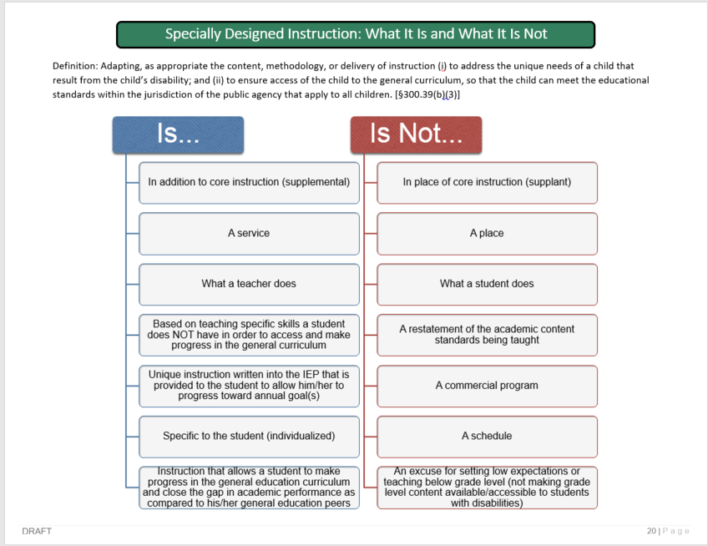

Slide 14
Specially Designed Instruction | Accommodations
 | Preferential seating
Provide increased time to interact with the concepts and to improve instructional delivery | Extended time
Increase opportunities to respond to the instruction given by using questions and having students explain their thinking | Allow adequate response time
Color highlighting on the whiteboard or having the student highlight their paper will help draw the students to key information and details to help them organize it in a way that makes sense to them | Highlighted material (material is already highlighted for the student)
Think-Pair-Share encourages students to think about a question and then refine their understanding through discussion with a partner-this allows the teacher time to go around and listen to the students thinking and understand where they are in their learning | Peer buddy/Peer tutoring
Chunking-The teacher will chunk the concept they are instructing on | Modified test and assignments

Slide 15
IEP Services
The IDEA requires IEPs to “include information about the amount of services that will be provided to the child, so that the level of the [school’s] commitment of resources will be clear to parents and other IEP Team members. The amount of time to be committed to each of the various services to be provided must be appropriate to the specific service, and clearly stated in the IEP in a manner that can be understood by all involved in the development and implementation of the IEP.
Federal Register, Vol 71, No. 156, p. 46667

Slide 16
Determining Service Types
Descriptions of special education and related services must:
Reflect the areas of identified need as documented in the student’s Present Levels of Academic Achievement and Functional Performance (PLAAFP) statement, and
Align with one or more of the student’s annual IEP goals.
If an IEP service cannot be directly linked to an IEP goal, the IEP team should consider whether the service is necessary for the student to make progress. Similarly, if a student has an IEP goal in a particular area, the IEP should include special education or related services to assist the student with achieving that goal.

Slide 17
Service Descriptions
IEP service descriptions should be labeled as accurately as possible to reflect the student’s specific academic, behavioral, or functional skill area of need (as documented in the student’s PLAAFP).
Examples of appropriate service descriptions might include reading comprehension, social skills, basic math skills, functional communication skills, or speech therapy.
Services should never be labeled based on a course name or description such as “geography,” “English language arts,” or “directed studies,” because course or content area descriptions do not always reflect the specific skills that will be taught or services that will be provided.

Slide 18
Determining Service Amounts
Service amounts should be based on the student’s needs, as documented in the student’s data.
Questions to consider:
What can the student do presently? What are the student’s strengths and areas of need?
How much improvement over time has the student shown when provided an intervention in the target skill area for a specific duration and frequency?
Based on the intervention, how much time per session and how often should a service be provided to ensure a high likelihood that the student will make meaningful progress?
What effect might the amount of special education services proposed have on the student’s access to the general education curriculum and non-disabled peers?

Slide 19
Service Amounts Based on Student Need
Service amounts should not be based on factors that are unrelated to the student’s individual needs for service or IEP goals.
Duration of services (amount of time per session) should never be calculated based solely on the length of a standard “period” of class time in the school’s master schedule.
Frequency of services (number of sessions per week) should never be calculated based solely on how frequently a course or designated subject is scheduled within the week of the school’s master schedule.
If an IEP team determines that a student requires a special education or related service for a specific amount of time per session, the special education service provider must ensure that the service is provided for the entire duration of time documented in the IEP.

Slide 20

Questions?
Lindsey Cunningham
Lindsey.Cunningham@schools.Utah.gov
UPIPS and SLD Specialist
Utah State Board of Education

