Slide 1
Elementary DLI Parent Information Night
October 22, 2020
Notes:
Ofelia - RECORD presentation

Slide 2
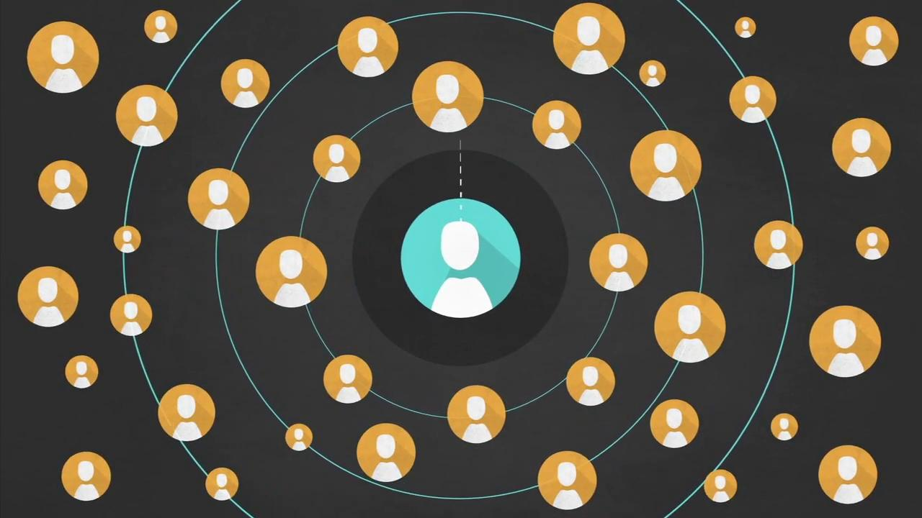
VIDEO
Notes:
Ofelia

Slide 3
Welcome & Introductions
Ofelia Wade: Elementary Team Lead
Raúl Martín: Spanish Specialist
Summer Wu: Chinese Specialist
Julie Butler: French Specialist
Michéle Harward: Secondary Team Lead
Amy Gutierrez: Secondary Specialist
Allison Duncan: Secondary Specialist
Zennie Frisby--Administrative Assistant
Notes:
On behalf of Canyons School District and the Instructional Support Department Language Team, we are delighted that you would join us tonight for this year’s Parent Orientation Meeting about the Dual Language Immersion Program.
We thank you for your time and for your interest in this educational option for your student.
I would like to this opportunity to introduce the language Team that supports the DLI programs in Canyons.
Our language Team is made up of 7 Team members as you can on the slide--
The Team is represented here tonight by Raul Martin--Raul would you wave --Raul supports our Spanish programs,
Summer Wu--Summer would you wave--Summer supports our Chinese programs
Julie Butler--Julie would you wave--Julie supports our French programs.

Slide 4
Tonight’s Agenda
Overview of the Elementary DLI Program Model
Introduction of the Schools & Principals
Application & Lottery Selection Process
Parent Responsibilities
Q & As
Opportunity to visit with the principals of the three language programs offered in Canyons.
Notes:
Tonight’s presentation will follow this agenda:

Slide 5
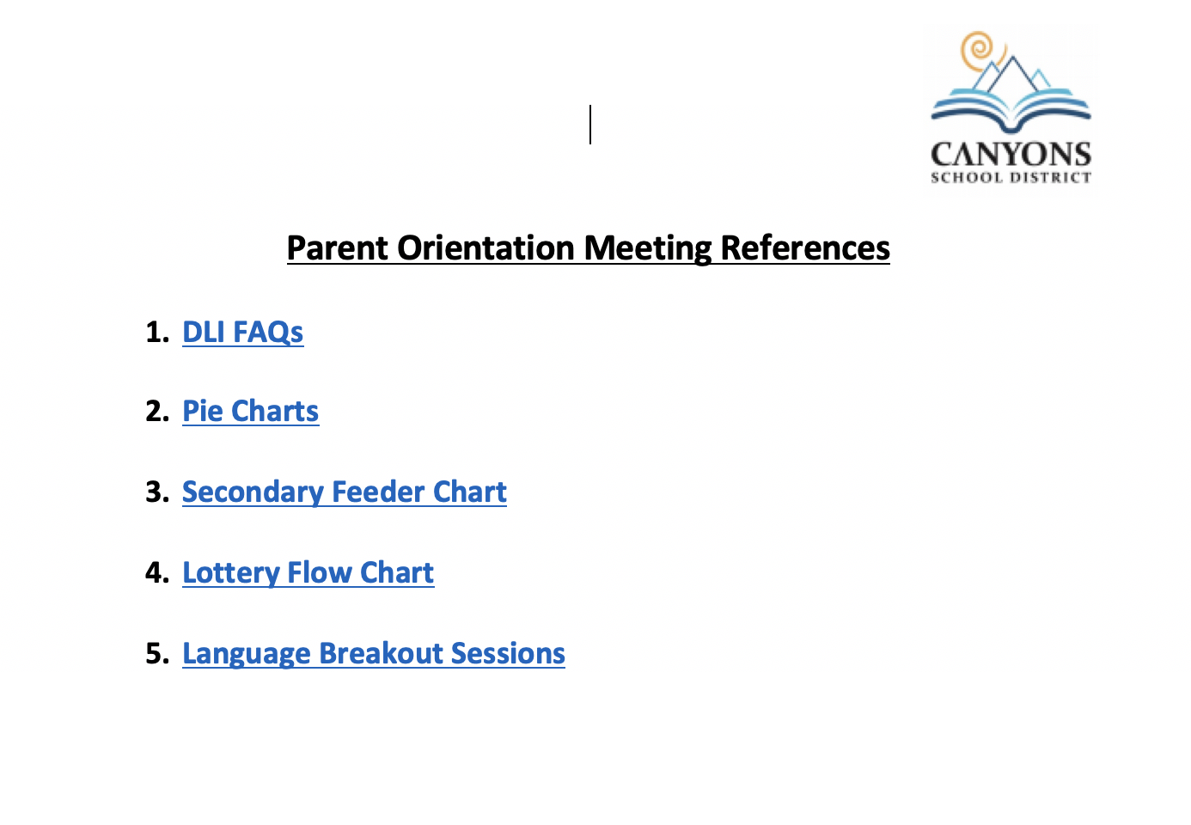
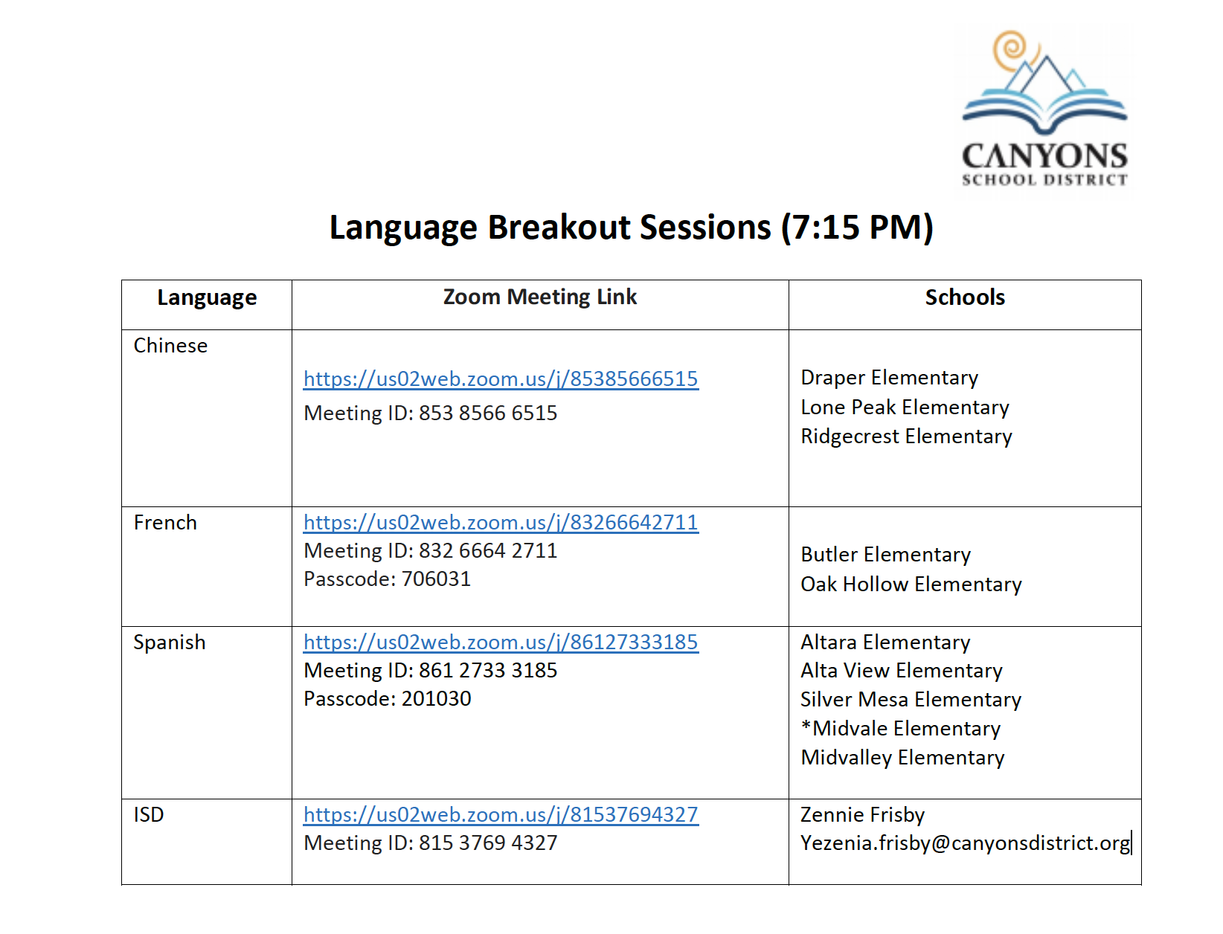
Breakout Sessions & Reference Documents

Slide 6
Program Goals
Academic achievement across all subject areas
Proficiency in English and Target language
Prepare students for cross-linguistic and cross-cultural encounters; enhanced intercultural understanding
Notes:
Ofelia
All the immersion programs in Canyons School District follow the Utah State Dual Language Immersion Model and they share 3 common program goals:
When we refer to the first goal ot Academic Achievement Across Subjects We want to know that your student’s academic progress in all academic areas such as Math, Science, Social Studies and English Language Arts will be monitored with the same monitoring measures that the District uses to monitor academic progress for all students in Canyons District.
The student’s language progress in the second language will be monitored using an informal tool in grades K-2 and a formative tool that is also used in grades 3-9. We will introduce both of these tools later in the presentation. These are monitoring measures that are specific to language proficiency in the immersion language. In Canyons that would be Chinese, French and Spanish.
The good news is that we a plethora of research spanning 60 years plus demostrating that these are not simple program goals, but rather consistent outcomes of the dual language immersion programs.

Slide 7
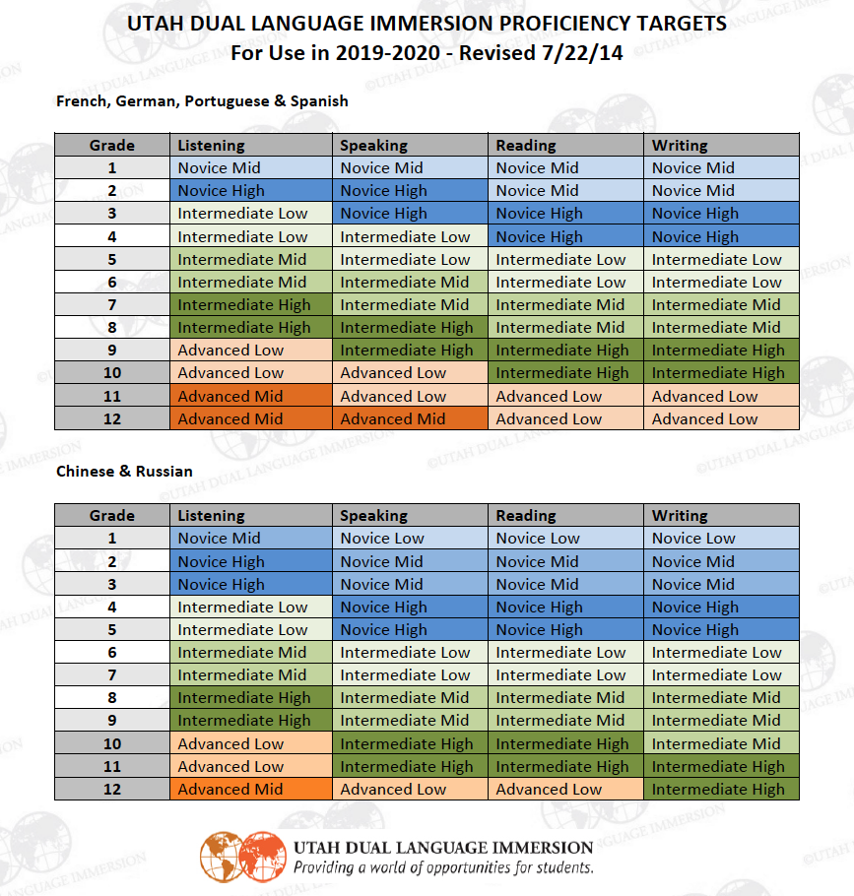
Program Targets
Notes:
The

Slide 8
Program Model
Starts in Kindergarten or 1st Grade
Teaches the Utah Core Curriculum
Uses a two-teacher model
Content subjects are divided by languages in grades K-5
Notes:
O

Slide 9
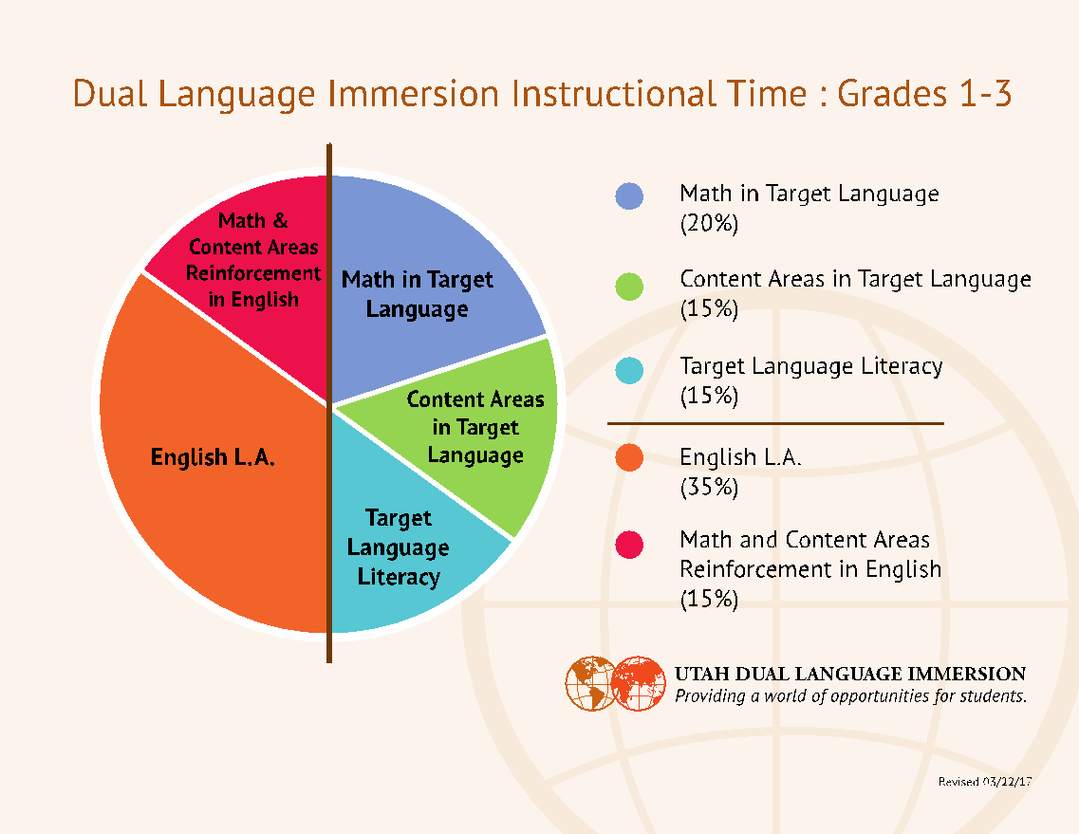
Elementary Program Model
Notes:
O

Slide 10
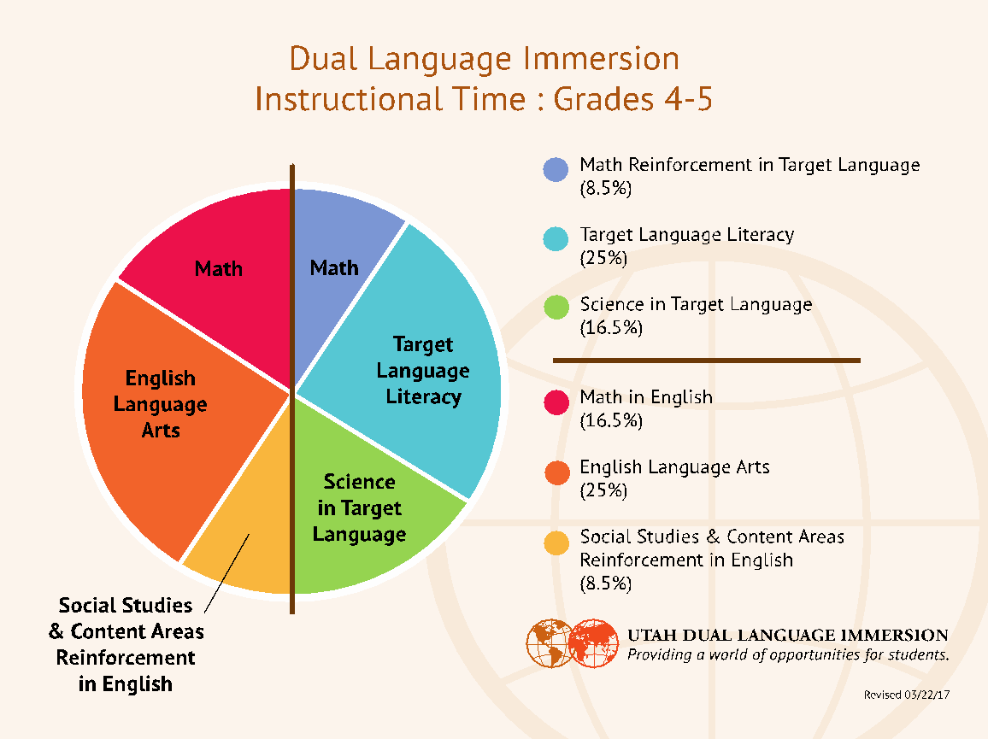
Elementary Program Model
Notes:
O

Slide 11
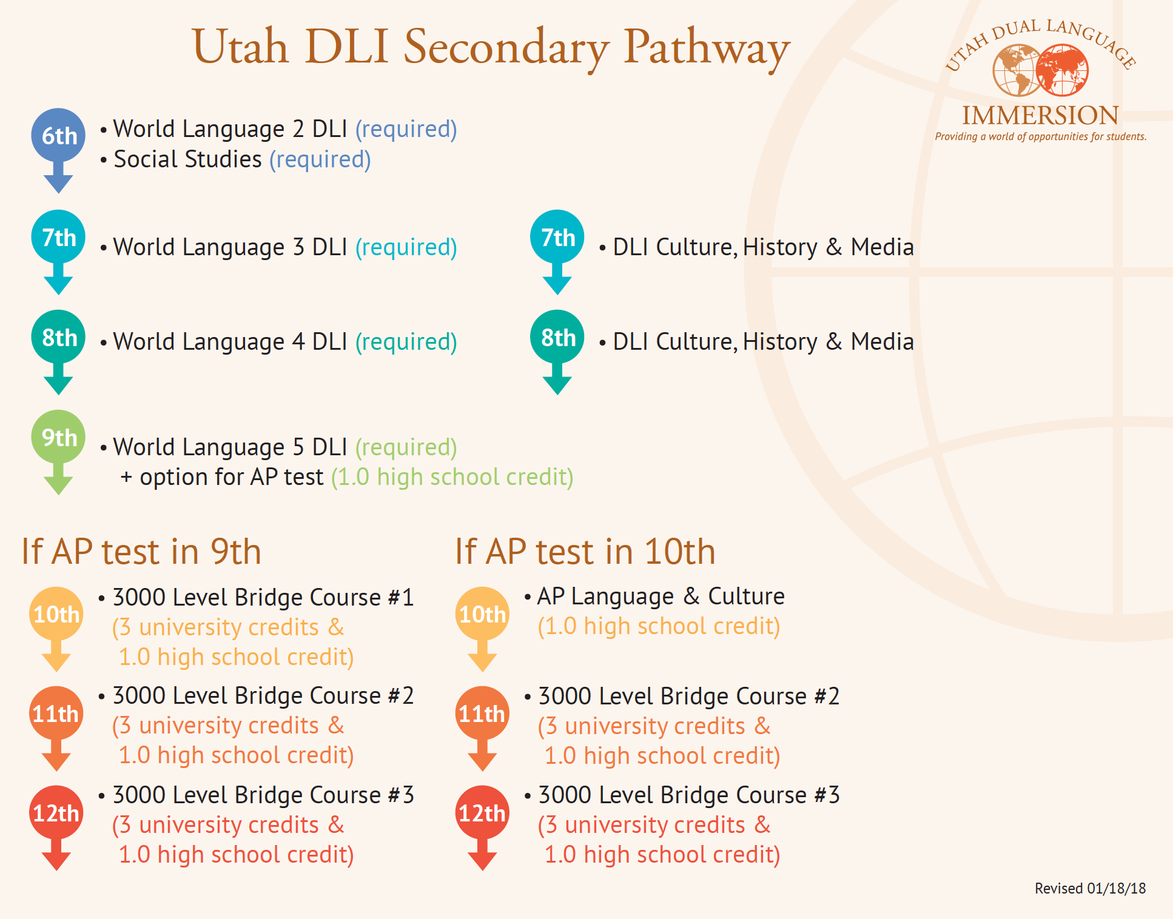
Secondary Articulation
Notes:
O

Slide 12
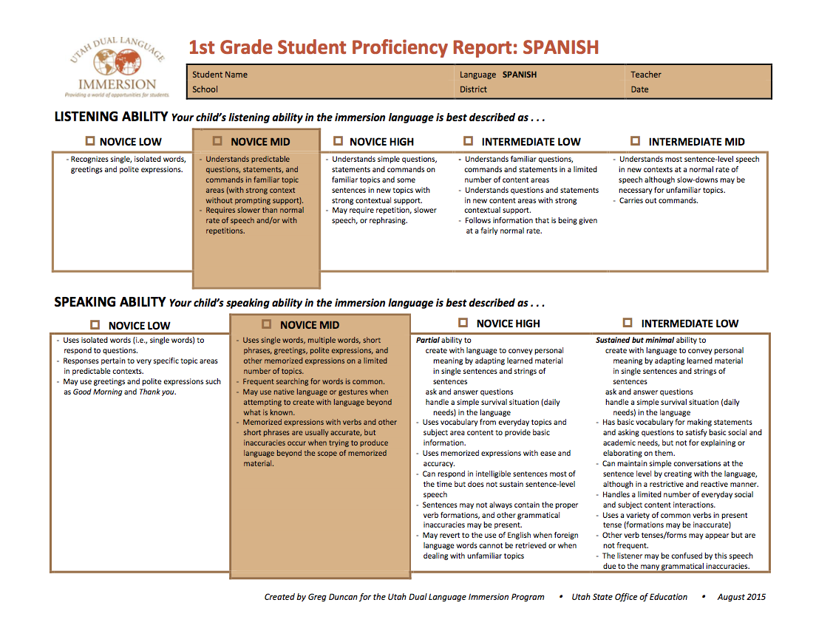
Formative Progress Monitoring
Notes:
O

Slide 13
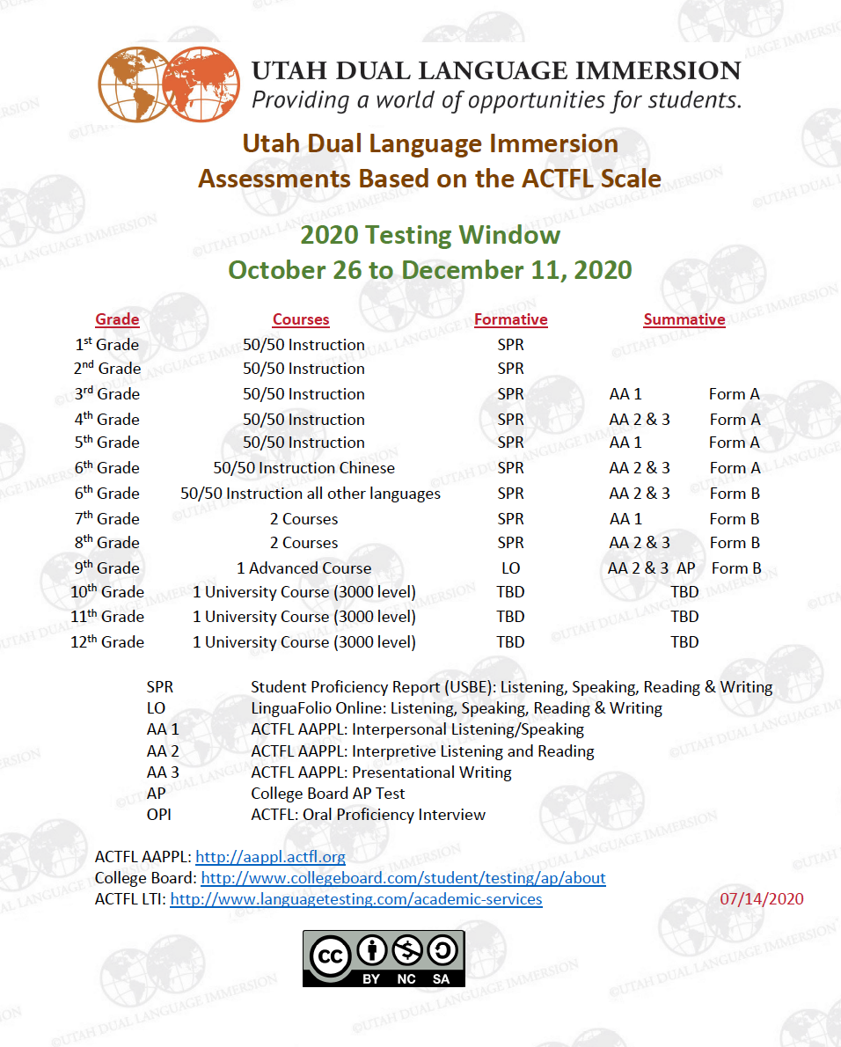
Summative Progress Monitoring
Notes:
O

Slide 14

Summative Progress Monitoring
3rd Grade | Listening & Speaking
4th Grade | Reading & Writing
5th Grade | Listening & Speaking
6th Grade | Listening, Speaking, Reading, Writing
7th Grade | Listening & Speaking
8th Grade | Reading & Writing
9th Grade | Listening, Speaking, Reading & Writing
Notes:
O

Slide 15
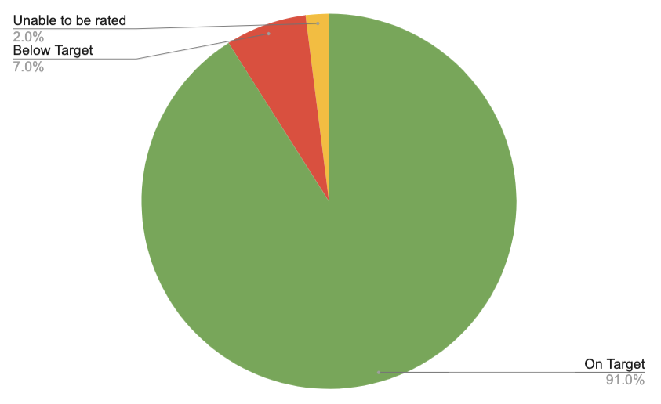
AAPPL Results for 2019
5th-grade results for listening & speaking
Notes:
O

Slide 16
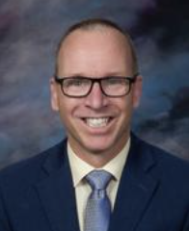
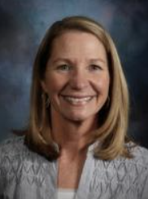
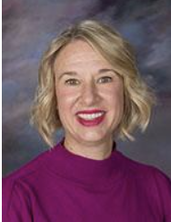
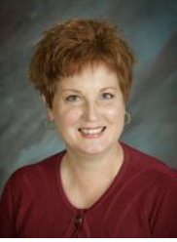
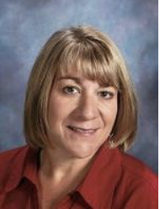
Canyons DLI Schools
Chinese
Draper Elementary
  Christy Waddell
Lone Peak Elementary
  Tracy Stacy
Ridgecrest Elementary
  Julia Winfree
French
Butler Elementary
  Jeff Nalwalker
Oak Hollow Elementary
  Julie Mootz
Notes:
Ofelia

Slide 17
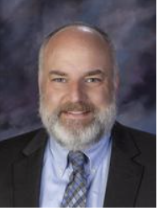
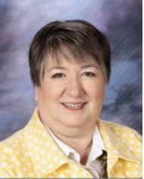
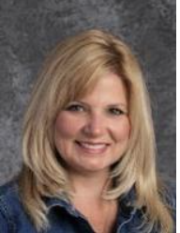
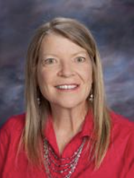
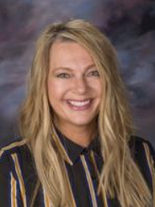
Canyons DLI Schools
Spanish
Alta View Elementary
  Scott Jameson
Altara Elementary
  Nicole Svee Magann
Midvale Elementary
  Lori Reynolds
Spanish
Midvalley Elementary
  Tamra Baker
Silver Mesa Elementary
  Julie Fielding
Notes:
Ofelia

Slide 18
Secondary DLI Schools
Elementary Middle High
Chinese
Draper
Lone Peak
Ridgecrest
Draper Park
Indian Hills
Butler
Corner Canyon
Alta
Brighton
French
Butler
Oak Hollow
Butler
Draper Park
Brighton
Corner Canyon
Spanish
Altara
Alta View
Midvale
Midvale
Silver Mesa
Mt. Jordan
Union
Midvale
Jordan
Hillcrest
Notes:
Ofelia

Slide 19

Any questions?
Notes:
Raúl reads questions

Slide 20
Breakout Sessions & Reference Documents
Notes:
O

Slide 21
Who Can Apply
All students entering first grade.
- At Midvale Elementary only, students entering K, and who live within the school’s boundaries can apply for the program.
Canyons School District students will be given first priority and then spots will be opened to those outside of the district if space is available.
Notes:
R - onwards

Slide 22
Lottery Timeline
Submit online application by end of November 25, 2020.
Notification of selection by lottery made via email on or before January 10, 2021.
If selected, electronic placement acceptance is due by February 1, 2021.
Notes:
r

Slide 23

How to Apply
Notes:
Raúl

Slide 24
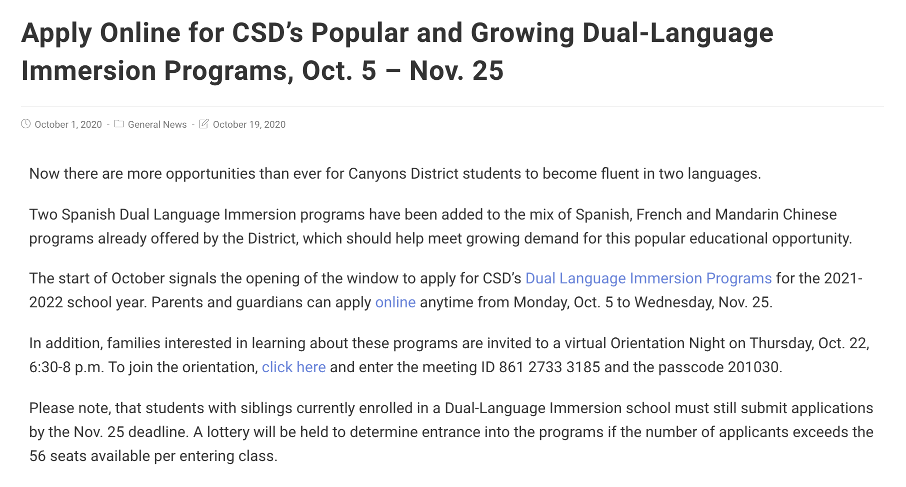
Application Process
Notes:
R

Slide 25

Application Process
Notes:
R

Slide 26
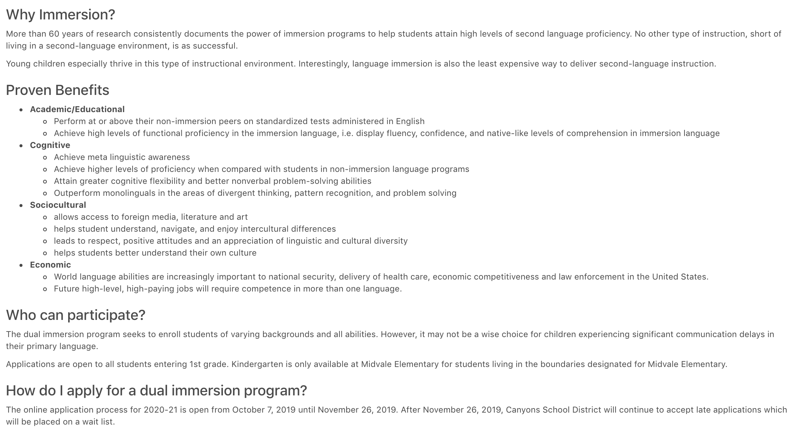
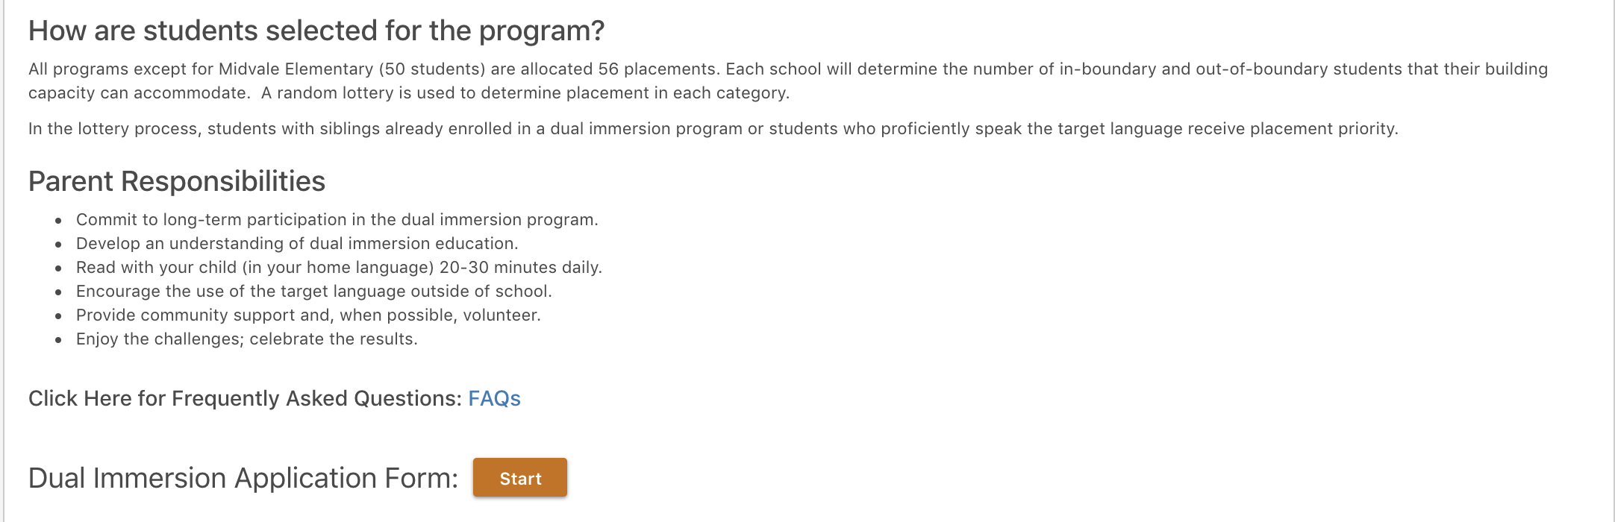
Application
Notes:
R

Slide 27
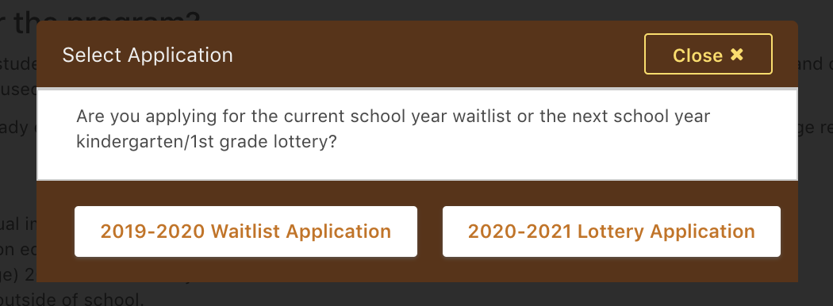
Application
Notes:
R

Slide 28
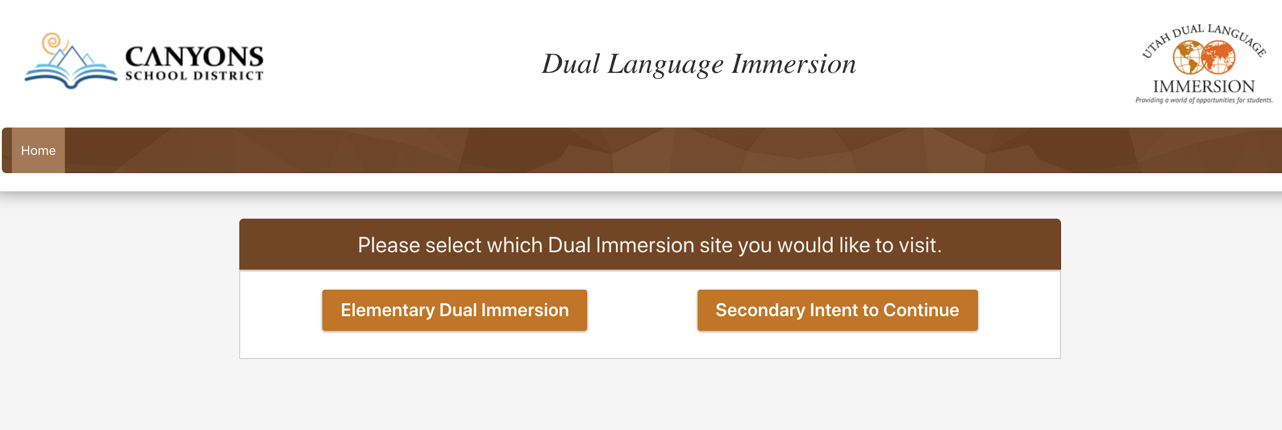
Application
Notes:
R

Slide 29
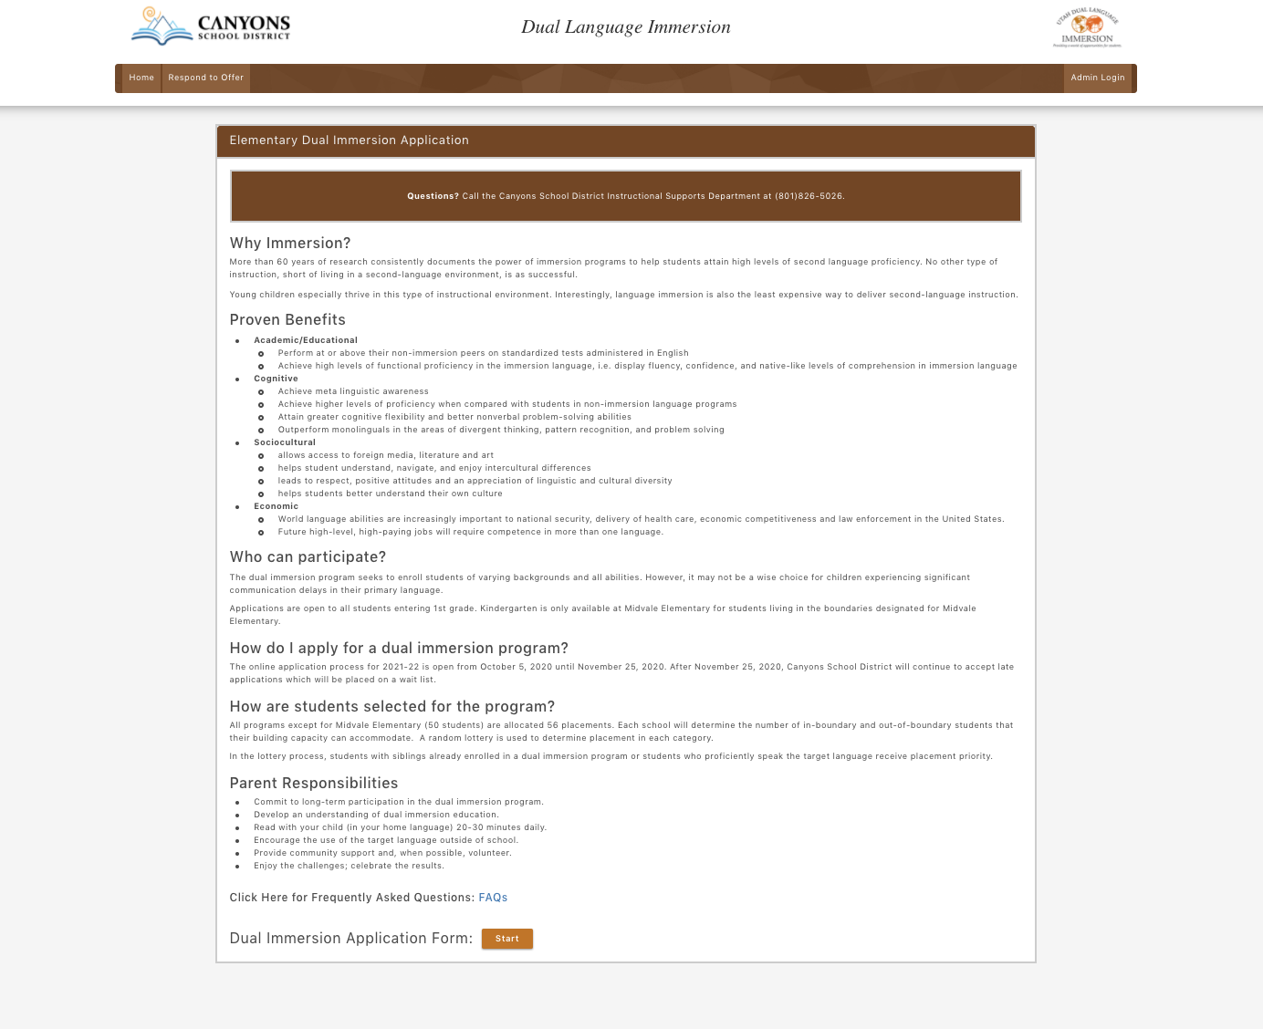
Application
Notes:
R

Slide 30
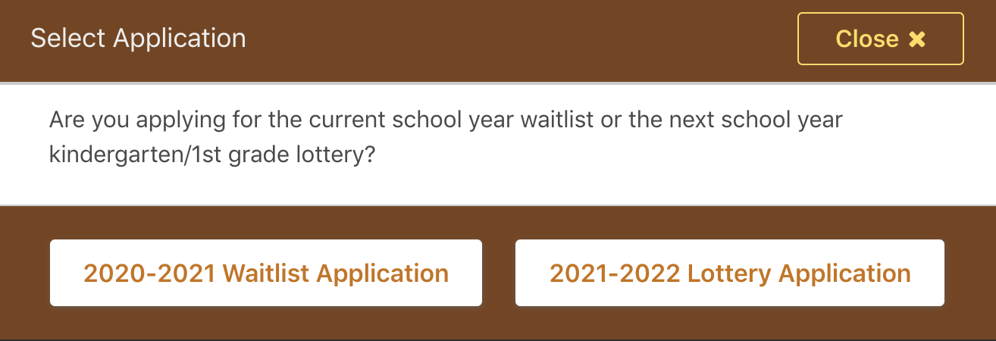

Slide 31
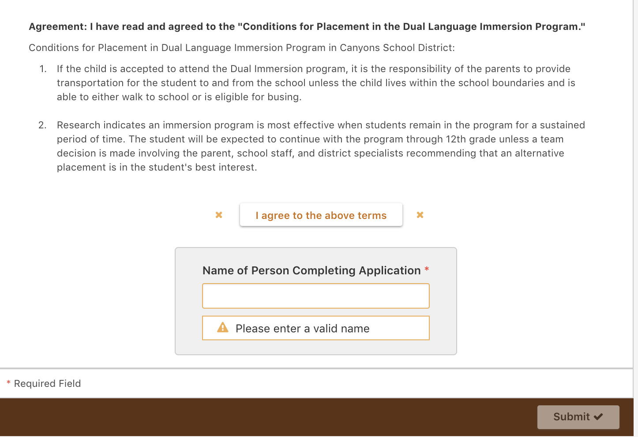
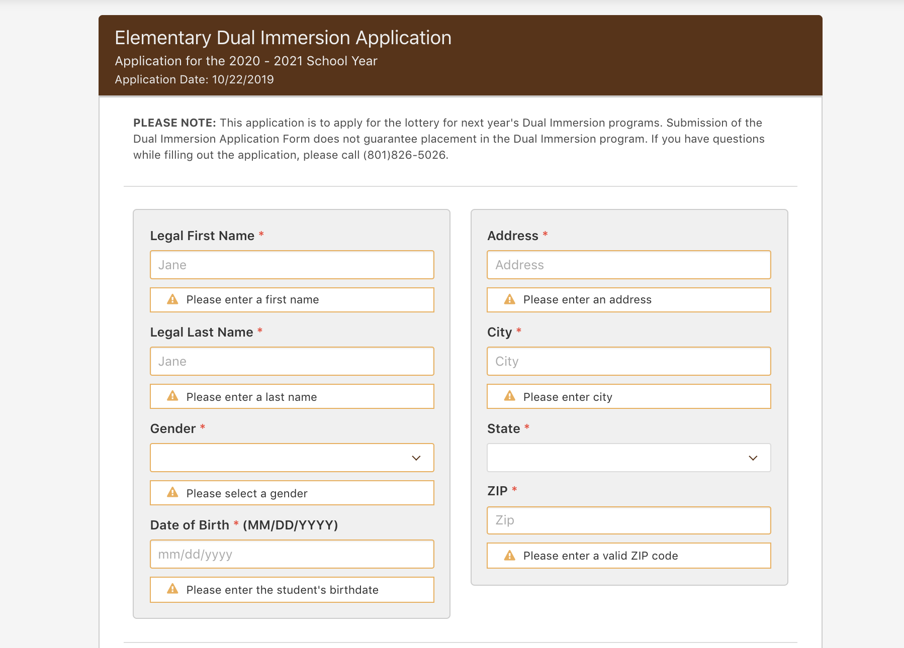
Application
Notes:
R
highlight: at the bottom, you have to click in the I AGREE, put name, and MUST not forget to SUBMIT. When you have clicked submit, you should get a notification about it. It is at the very bottom.

Slide 32
Selection Criteria
56 students per program (per school)
  50 at Midvale (only open to students who live within the school’s boundaries)
Siblings of students already in the immersion program are given priority, if an application is submitted on time.
Students with high levels of proficiency (native-like speakers, readers, writers) in the target language are given priority.
Notes:
Ofelia

Slide 33
Parents’ Role
Develop an understanding of immersion education
Commit to long-term participation
Encourage the use of the target language outside of school
Read to your child in English/home language
Provide transportation should you live outside of the boundaries of the attending school
Notes:
Raul once your child is in the program, the question is: how do I support that?
which you are doing
this is not a one year program, this is a k12, if you child is to gain the full benefit of an immersion, this is a long term participation committment
Provide: opportunities in the community to the language that is being learned in their community: restaurants, festivals, movies, organizations that sponsor movie festivals or activities, the mexican consulate does the same with movies for children… so that the children can interact with native speakers or with second language speakers outside of the classroom .
Encourage
Read to your child in English: we want to have your children experience lots of different things and situations, outside of the classroom.
Provide transportation: part of the opportunity is that the student is on time and has an approrpiate way of getting to the school.

Slide 34
Opportunity to Visit
with Schools

Slide 35
Breakout Sessions & Reference Documents

Slide 36

Notes:
Ofelia

