Slide 1
Sexual Harassment (Title IX)
CSD - Administrative Training
Assistant Legal Counsel/Title IX Coordinator
Jeffrey Christensen
Notes:
Thanks to BJ/Bob/Others.
It is good to be here, working in education, and associated with all of you today.

Slide 2
Dept. of Ed. releases new
Title IX Regulations
for Sexual Harassment
May 6th, 2020 to take effect
Aug 14th, 2020
Notes:
Responding to complaints that the Department of Education’s guidance did not adequately protect the rights of those accused of sexual harassment or sexual violence, in September, 2017 the DOE withdrew previous guidance and the following year, October, 2018, DOE proposed new regulations.
Those regulations are not yet effective, but were published for public comment (receiving over 100,000 comments), and finalized, ready for publication.
Since then, these regulations have been the target of a number of attempts to stop or at least alter their implementation
The consensus in the legal community is that pending litigation may eventually alter some of the new regs but it’s unlikely they will be successful prior to Aug 14, when compliance begins
2,000 pages

Slide 3
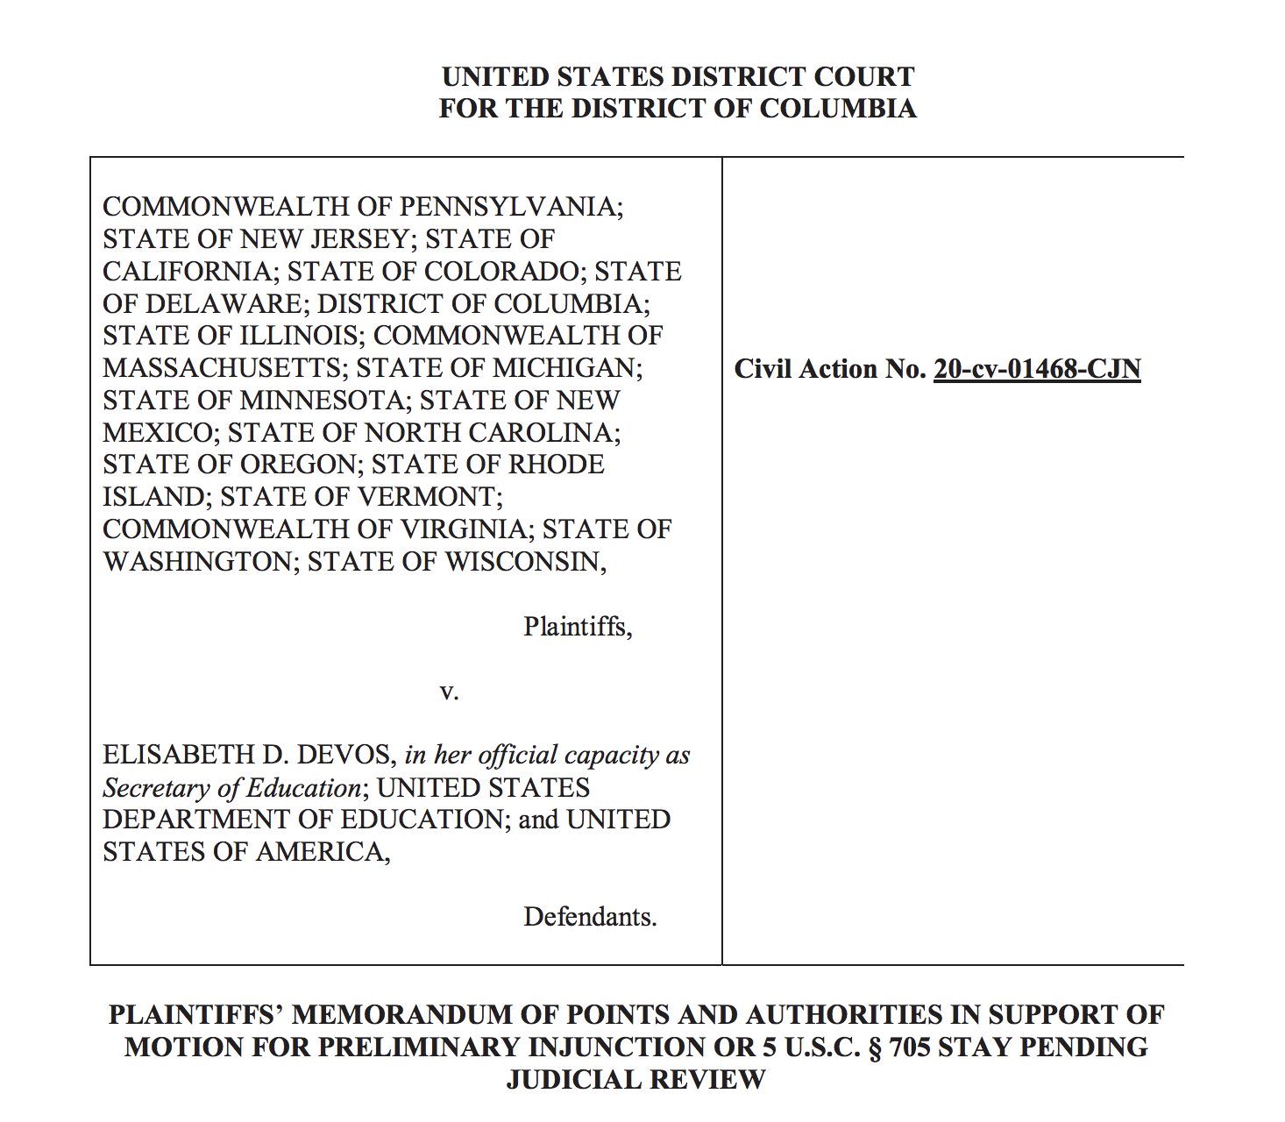
Notes:
Responding to complaints that the Department of Education’s guidance did not adequately protect the rights of those accused of sexual harassment or sexual violence, in September, 2017 the DOE withdrew previous guidance and the following year, October, 2018, DOE proposed new regulations.
Those regulations are not yet effective, but were published for public comment (receiving over 100,000 comments), and finalized, ready for publication.
Since then, these regulations have been the target of a number of attempts to stop or at least alter their implementation
The consensus in the legal community is that pending litigation may eventually alter some of the new regs but it’s unlikely they will be successful prior to Aug 14, when compliance begins
2,000 pages

Slide 4
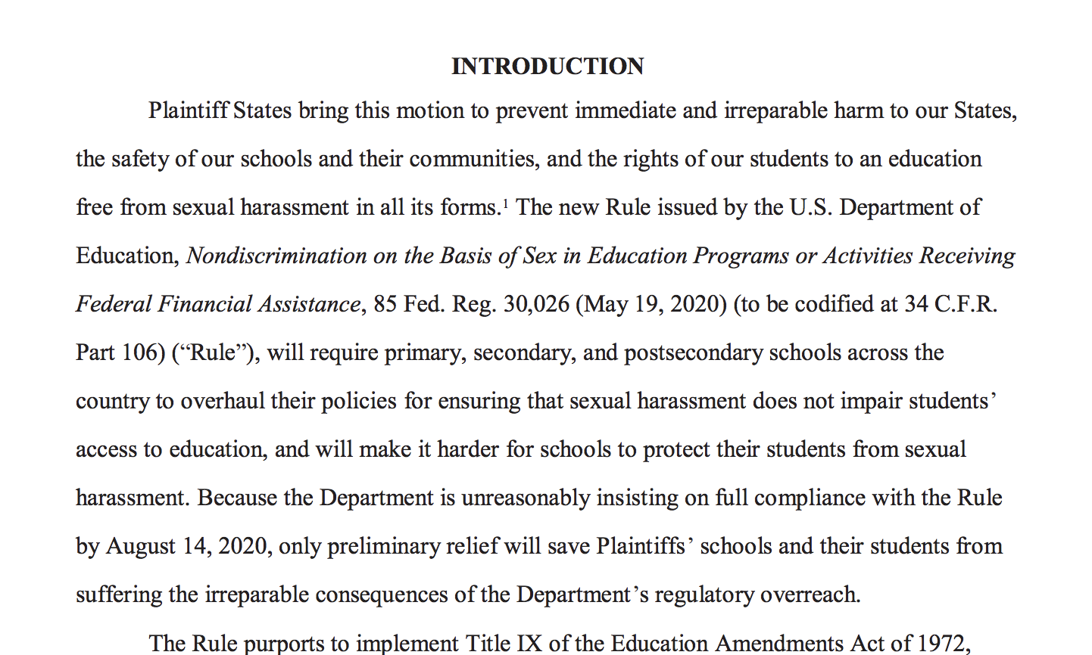
Notes:
Responding to complaints that the Department of Education’s guidance did not adequately protect the rights of those accused of sexual harassment or sexual violence, in September, 2017 the DOE withdrew previous guidance and the following year, October, 2018, DOE proposed new regulations.
Those regulations are not yet effective, but were published for public comment (receiving over 100,000 comments), and finalized, ready for publication.
Since then, these regulations have been the target of a number of attempts to stop or at least alter their implementation
The consensus in the legal community is that pending litigation may eventually alter some of the new regs but it’s unlikely they will be successful prior to Aug 14, when compliance begins
2,000 pages

Slide 5

Issue Reporting/Issue Spotting Training
Notes:
The goal of the training today is to provide an overview and focus on issue reporting and issue spotting.
High way metaphor:
We have become used to a certain process of disciplining students for policy infractions that is like the highway: wide, linear, and all inclusive.
The DOE’s new regulations on Title IX introduce additional due process requirements that is like a parallel “feeder” road—there are more stops and slower speed limit.
Sometimes issues will exit the main process high way and sometimes they will get back on the highway
Building leaders (with the help of the TIXC) will be tasked with knowing when sexual harassment cases need this extra process and require us to exit the highway onto the feeder road
We are calling this the Title IX jurisdictional analysis (does title IX have jurisdiction over the claim or not?)

Slide 6
Federal Law
Title IX of the Education Amendments of 1972 (“Title IX”) 20 U.S.C. §1681 et seq.
“No person in the United States shall, on the basis of sex, be excluded from participation in, be denied the benefits of, or be subjected to discrimination under any education program or activity receiving Federal financial assistance…”
Title IX is a federal civil rights law that prohibits discrimination on the basis of sex in education in federally funded
programs and activities.
Notes:
A few slides to refresh our minds re: Title IX

Slide 7
Title IX Issues
Sex-Based Discrimination
• Program Equity, Recruitment, Admissions and Access, Pregnancy, Athletics, Employment, Recruitment & Hiring, Extra-curricular Activities Housing, Access to Course Offerings, Salaries and Benefits, Financial Assistance, Facilities, Funding, Sex, Gender, Gender Identity
Sexual Harassment
• Quid Pro Quo, Hostile Environment, Sexual Assault, Domestic Violence
Dating Violence, Stalking
Retaliation

Slide 8
Sexual Harassment
Association or Title IX Administrators (ATIXA)
Investigate it
Stop it
Prevent it
Remedy it

Slide 9
Policy and Procedure Overview
Time-Line Foundational Case Law
Definition of “Sexual Harassment” and “actual knowledge”
“Incident Report” and Initial Assessment
Formal Complaint – Title IX (TIXC) Coordinator assessment for Dismissal

Slide 10
Policy and Procedure Overview
Investigation
Determination of Responsibility by Decision-maker (s)
Appeal
Case Studies

Slide 11
1972 Title IX enacted
1997 OCR issues guidance on sexual harassment recognizing responsibility of schools to respond
1974 HEW issues Title IX regs
1980 Title IX enforcement transferred to new ED OCR office
1992 SCOTUS recognizes student right to money damages for sexual harassment (Franklin v. Gwinnett)
1986 Jeanne Clery raped and murdered in her residence hall at Lehigh University
1990 Congress enacts Clery Act to require university reporting of violent crimes
1994 Congress enacts Violence Against Women Act (VAWA)

Slide 12
1997 OCR issues guidance on sexual harassment recognizing responsibility of schools to respond
1998 SCOTUS sets standard for teacher-on-student harassment liability as “deliberate indifference” after “actual notice” of misconduct (Gebser v. Lago Vista)
1999 SCOTUS recognizes school liability for student-on-student sexual harassment and adds a narrow definition (Davis v. Monroe)
2001-2017 OCR issues dozens of guidance documents (most from 2009-2016)
2020 May 6 U.S. Dept. of Ed. Issues new Title IX regs defining sexual harassment and spelling out investigation process
2013 VAWA reauthorization amends Clery Act to require university reporting of sexual assault, dating violence, domestic violence, stalking (big 4)

Slide 13
Supreme Court Cases
Davis v. Monroe County Bd. of Education, 536 U.S. 629 (1999)
A school board may be held liable in cases of student-on-student harassment, but only where the funding recipient is deliberately indifferent to sexual harassment, of which the recipient has actual knowledge, and that harassment is so severe, pervasive, and objectively offensive that it can be said to deprive the victims of access to the educational opportunities or benefits provided by the school.

Slide 14
Supreme Court Cases
Cannon v. University of Chicago, 441 U.S. 667 (1979)
Title IX includes an implied right of action (meaning people can sue under it).
Franklin v. Gwinnett County Public Schools, 503 U.S. 60 (1992)
Title IX not only provides equitable remedies to require fair treatment for males and females, it also provides for damage awards (i.e., district can be sued for money).

Slide 15
Remedies Under Title IX
An individual may assert a Title IX claim against the District by:
Lawsuit: Suing the school/District in court and seeking monetary damages or injunctive or declaratory relief.
And/Or
OCR Complaint: Filing an administrative complaint, a grievance with U.S. Dept. of Ed. Office for Civil Rights (or other applicable federal agency).

Slide 16
Civil Lawsuit v. Administrative Action
An individual may assert a Title IX claim against the District by:
Lawsuit: Filed in federal court. Money damages, injunction.
Requires: Actual notice, employee with authority to take action,
deliberate indifference.
OCR Complaint: Initiated by OCR, Voluntary compliance or finding. Requires: Actual notice, K-12 employee/appropriate school official with authority to take action, deliberate indifference.
“deliberate indifference”: The institution’s response to sexual harassment is clearly unreasonable in light of the known circumstances.

Slide 17
New Definition of “Sexual Harassment”:
An employee conditioning the provision of an aid, benefit, or service of the District’s on the individual’s participation in unwelcome sexual conduct. (Quid pro quo)
Unwelcome conduct determined by a reasonable person to be so severe,
pervasive, AND objectively offensive that it effectively denies a person equal
access to the school’s education program or activity; or (hostile environment)
Sexual assault, dating violence, domestic violence, or stalking. (criminal sexual behavior and Violence Against Women Act (VAWA)
Notes:
Narrowed (less expansive than workplace under Title VII for issues of free speech and academic freedom).
Commenters urged the department to use severe OR pervasive in keeping with the Supreme Court’s work-place harassment standard – given that a sexual assault may be severe – but not pervasive and some sexual or sexist remarks may be pervasive but not severe. The final regulations kept the same demanding standard, but, in response to critics, they now make clear that a single instance of sexual assault does constitute sexual harassment.
In its explanation, the department points to the fact that an educational environment may need to strike a different balance than the workplace with regard to student free speech and expression. “Schools are unlike the adult workplace. . .children may regularly interact in a manner that would be unacceptable among adults.”
Sexual Assault: rape, fondling, incest, or statutory rape.
Dating violence: threats or actual sexual or physical abuse in a dating relationship.
Domestic violence: crime of violence committed by former spouse, cohabiting partner, or someone with whom you share a child.
Stalking: ongoing conduct that could cause a reasonable person to fear for the safety of themselves or others, or suffer emotional distress (e.g., following, monitoring, threatening, communicating to or about the victim, or interfering with victim’s property)
Serious enough to deny or limit the victim’s ability to participate in or benefit from the school’s program.
Clery Act – named after Jeanne Clery who was raped and murdered in her dorm room by a fellow student on April 5, 1986. Requires colleges to report crimes that occur on campus and school safety policies. Also requires schools to send timely warnings to the school community when there are known risks to public safety on campus

Slide 18
Former definition “Sexual Harassment”:
sexual harassment as “[c]onduct of a sexual nature [that] is sufficiently severe, persistent, OR pervasive to limit a student’s ability to participate in or benefit from the education program, or to create a hostile or abusive educational environment.”
*This definition broadly included a variety of conduct that could interfere in a student’s ability to participate in school, ranging from physical conduct such as rape, groping, and other nonconsensual sexual contact to verbal harassment.
Notes:
Narrowed (less expansive than workplace under Title VII for issues of free speech and academic freedom).
Commenters urged the department to use severe OR pervasive in keeping with the Supreme Court’s work-place harassment standard – given that a sexual assault may be severe – but not pervasive and some sexual or sexist remarks may be pervasive but not severe. The final regulations kept the same demanding standard, but, in response to critics, they now make clear that a single instance of sexual assault does constitute sexual harassment.
In its explanation, the department points to the fact that an educational environment may need to strike a different balance than the workplace with regard to student free speech and expression. “Schools are unlike the adult workplace. . .children may regularly interact in a manner that would be unacceptable among adults.”
Sexual Assault: rape, fondling, incest, or statutory rape.
Dating violence: threats or actual sexual or physical abuse in a dating relationship.
Domestic violence: crime of violence committed by former spouse, cohabiting partner, or someone with whom you share a child.
Stalking: ongoing conduct that could cause a reasonable person to fear for the safety of themselves or others, or suffer emotional distress (e.g., following, monitoring, threatening, communicating to or about the victim, or interfering with victim’s property)
Serious enough to deny or limit the victim’s ability to participate in or benefit from the school’s program.
Clery Act – named after Jeanne Clery who was raped and murdered in her dorm room by a fellow student on April 5, 1986. Requires colleges to report crimes that occur on campus and school safety policies. Also requires schools to send timely warnings to the school community when there are known risks to public safety on campus

Slide 19
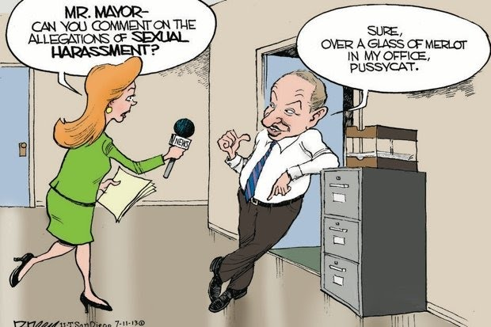
Quid Pro Quo
Must be by employee
Principal promises bad evaluation if teacher doesn’t give him a massage
Teacher offers student higher grade if student kisses her
Coach implies athlete will start if she lets him sit close and rub her legs

Slide 20
*Most difficult - Definition of “Sexual Harassment” (con’t)
Severe: The more severe the conduct, the less need there is to show a repetitive series, particularly if physical. A single act may be severe. Non consensual sexual intercourse or contact are almost always sufficiently severe. The ability for the victim to escape harassment.
Pervasive – Widespread, openly practiced; is there a pattern; well-known among students or employees – reputation of a department, person, etc. Occurring in public spaces (more likely to be pervasive). Frequency, intensity, or duration.
Objectively Offensive: reasonable person standard (age and relationships of accuser and accused; number of persons involved; frequency; severity; humiliation; and intimidation).
Notes:
Commenters urged the department to use severe OR pervasive in keeping with the Supreme Court’s work-place harassment standard – given that a sexual assault may be severe – but not pervasive and some sexual or sexist remarks may be pervasive but not severe.
The final regulations kept the same demanding standard, but, in response to critics, they now make clear that a single instance of sexual assault does constitute sexual harassment.
In its explanation, the department points to the fact that an educational environment may need to strike a different balance than the workplace with regard to student free speech and expression. “Schools are unlike the adult workplace. . .children may regularly interact in a manner that would be unacceptable among adults.”
***Davis v. Monroe: Severe not only verbal it also included acts of objectively offensive touching, over a period of 5 months.

Slide 21
What about these?
Unwelcome flirting
Sexual invitations
Sexual comments
Sexual jokes
Explicit images
Spreading rumors
Teasing
Massaging
Sexual touching (self or others)
Exposing body parts (mooning, pantsing, streaking, etc.)
Sexting

Slide 22
Definition of “Sexual Misconduct”:
Unwelcome sexual actions or conduct that is both non-physical or physical, offensive to the sensibilities of any person, including sexual advances, lewd gestures, words or other communication of sexual nature that has the effect of threatening or intimidating the person against whom such conduct is directed.
This conduct or behavior does not meet the definition of sexual harassment under Title IX for a hostile environment for sexual conduct that is severe, pervasive, and objectively offensive to deny a person equal access to the education program or activity.
Notes:
Commenters urged the department to use severe OR pervasive in keeping with the Supreme Court’s work-place harassment standard – given that a sexual assault may be severe – but not pervasive and some sexual or sexist remarks may be pervasive but not severe. The final regulations kept the same demanding standard, but, in response to critics, they now make clear that a single instance of sexual assault does constitute sexual harassment.
In its explanation, the department points to the fact that an educational environment may need to strike a different balance than the workplace with regard to student free speech and expression. “Schools are unlike the adult workplace. . .children may regularly interact in a manner that would be unacceptable among adults.”

Slide 23
Definition of “Sexual Misconduct” (con’t):
CASE 1
A girl's mom came to the office today to report that male Student A had said sexually inappropriate things to her student. When the girl arrived at the office, she reported that male Student A had asked her if she liked to make telescopes. She told him that she had never made one and male Student A laughed. Confused, she repeatedly asked what he meant. Student A replied that there was a rumor going around that she touched boys penises and made them telescope.
Severe?
Pervasive?
Objectively Offensive?
Notes:
Commenters urged the department to use severe OR pervasive in keeping with the Supreme Court’s work-place harassment standard – given that a sexual assault may be severe – but not pervasive and some sexual or sexist remarks may be pervasive but not severe. The final regulations kept the same demanding standard, but, in response to critics, they now make clear that a single instance of sexual assault does constitute sexual harassment.
In its explanation, the department points to the fact that an educational environment may need to strike a different balance than the workplace with regard to student free speech and expression. “Schools are unlike the adult workplace. . .children may regularly interact in a manner that would be unacceptable among adults.”

Slide 24
Definition of “Sexual Misconduct” (con’t):
CASE 2
Male student was bending over to pick up a binder and a water bottle and Female 1 came out of the girls locker room with another Female student at the same time. Female thought it'd be a good idea yell, "Hey Male Student, nice view!" Instructor had a conversation with Female 1 about sexual harassment to which Female 1 replied "I didn't know that wasn't ok."
Severe?
Pervasive?
Objectively Offensive?
Notes:
Commenters urged the department to use severe OR pervasive in keeping with the Supreme Court’s work-place harassment standard – given that a sexual assault may be severe – but not pervasive and some sexual or sexist remarks may be pervasive but not severe. The final regulations kept the same demanding standard, but, in response to critics, they now make clear that a single instance of sexual assault does constitute sexual harassment.
In its explanation, the department points to the fact that an educational environment may need to strike a different balance than the workplace with regard to student free speech and expression. “Schools are unlike the adult workplace. . .children may regularly interact in a manner that would be unacceptable among adults.”

Slide 25
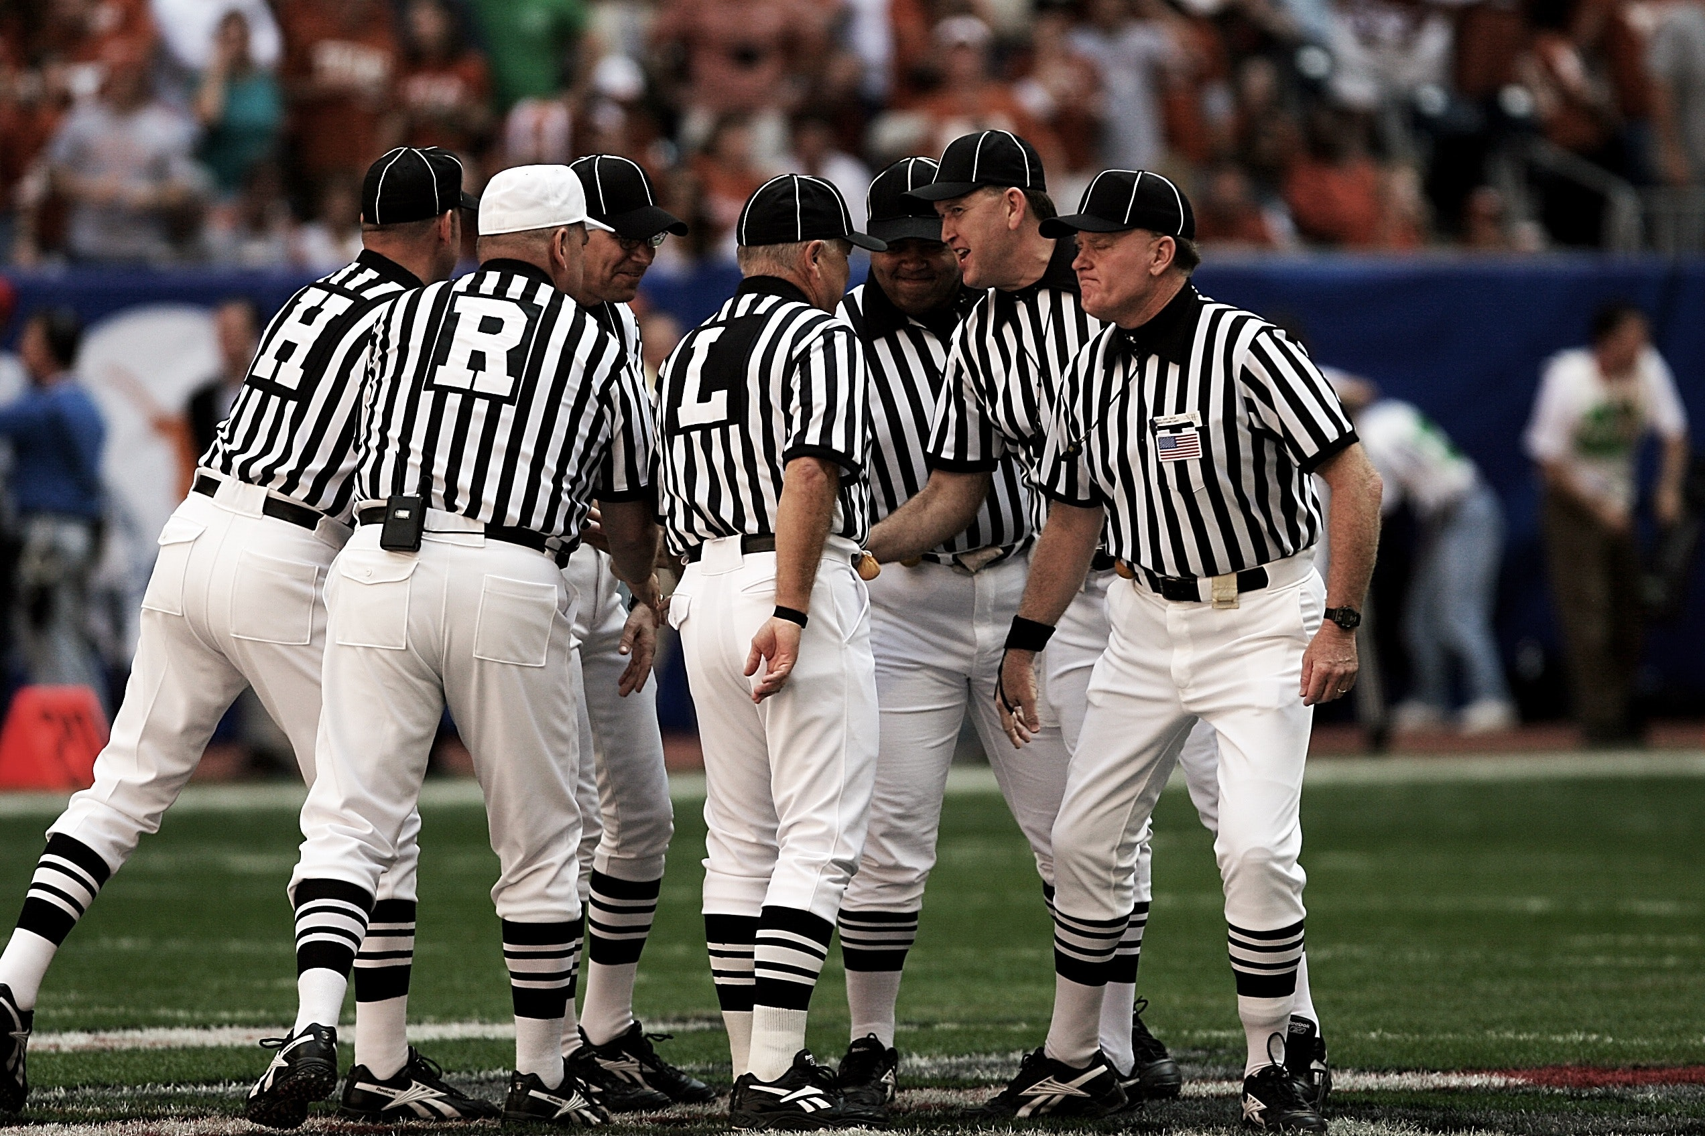
YOU
make the call
OU
**Seriously Report incidents/Questions to the Title IX Coordinator.
Notes:
A school must respond when the school has actual knowledge of sexual harassment that occurred within the school’s education program or activity. Notice results whenever any elementary or secondary school employee, any Title IX Coordinator, or any official with authority to respond - witnesses sexual harassment; hears about sexual harassment or sexual harassment allegations from a complainant (i.e., a person alleged to be the victim) or a third party (e.g., the complainant’s parent, friend, or peer); receives a written or verbal complaint about sexual harassment allegations; or by any other means.
It is a recipient’s own misconduct – not the sexually harassing behavior of employees, students, or other third parties – that subjects the District to liability. OCR will not find that a school violated Title IX unless the school had ‘actual knowledge’ of a sexual-harassment allegation and showed “deliberate indifference” – meaning that it responded in a way that is “clearly unreasonable in light of the know circumstances.” The rule sets out extensive, detailed obligations that schools must fulfill in response to complaints.
Serious enough to deny or limit the victim’s ability to participate in or benefit from the school’s program.

Slide 26
Definition “actual knowledge”:
means notice of sexual harassment or allegations
In an education program or activity
Against a person in US
To:
Title IX Coordinator
any school official who has authority to institute corrective measures on behalf of the District;
or to any elementary or secondary school employee.
**Report incidents of sexual harassment to the Title IX Coordinator or Deputy Title IX Coordinator (s).**
Notes:
A school must respond when the school has actual knowledge of sexual harassment that occurred within the school’s education program or activity. Notice results whenever any elementary or secondary school employee, any Title IX Coordinator, or any official with authority to respond - witnesses sexual harassment; hears about sexual harassment or sexual harassment allegations from a complainant (i.e., a person alleged to be the victim) or a third party (e.g., the complainant’s parent, friend, or peer); receives a written or verbal complaint about sexual harassment allegations; or by any other means.
It is a recipient’s own misconduct – not the sexually harassing behavior of employees, students, or other third parties – that subjects the District to liability. OCR will not find that a school violated Title IX unless the school had ‘actual knowledge’ of a sexual-harassment allegation and showed “deliberate indifference” – meaning that it responded in a way that is “clearly unreasonable in light of the know circumstances.” The rule sets out extensive, detailed obligations that schools must fulfill in response to complaints.
Serious enough to deny or limit the victim’s ability to participate in or benefit from the school’s program.

Slide 27
Incident Report and Initial Assessment
(When does Title IX Apply?)
Part 1: Jurisdictional Issues and Questions?
Does the District have control over the harasser and the context of the harassment? Is it part of an “education program or activity” meaning . . .
  Location, events, or circumstances under substantial control?
  Any building owned or controlled by an officially recognized student organization
A person in the United States.
If no jurisdiction, Title IX does not apply, BUT others policies may apply.

Slide 28
Incident Report and Initial Assessment
(When does Title IX Apply? Con’t)
Part 2: Does the conduct or alleged conduct meet the definition for sexual harassment under the new regulations?
Quid Pro Quo?
Sexual Harassment?
Severe
Pervasive; and
Objectively reasonable
Sexual assault (forcible rape, forcible sodomy, forcible fondling), dating violence, domestic violence, or stalking (criminal sexual behavior).
If conduct does not meet definition of sexual harassment, Title IX does not apply, BUT other policies may apply.

Slide 29
Incident Report and Initial Assessment
(When does Title IX Apply? Con’t)
Promptly contact the complainant
Consider the complainant’s wishes (legal/guardian) on how to address the issue
Explain process of filing a formal complaint (Form on Legal Services site)
*Actual knowledge triggers Title IX supportive measures. Consider the “down-stream effects” The definition of sexual harassment arguable covers the in-program effects of out-of-program misconduct (i.e., nexus).
If supportive measures are not provided, document why.
Notes:
Promptly contact complainant (person who may be experiencing sexual harassment)
Consider complainant’s wishes on how to address the issue
Provide supportive measures (with or without formal complaint) designed to restore or preserve access to the school’s education program or activity without unreasonably burdening the other party, protect the safety of all parties and the school’s educational environment, and deter sexual harassment. Supportive measure should be non-disciplinary, non-punitive individualized services offered as appropriate, as reasonably available, and without fee or charge to the complainant and, as applicable to a respondent as well.
Explain process for filing a formal complaint and their right to file a complaint

Slide 30
Supportive Measures
Non-disciplinary, non-punitive
Individualized services
Restore or preserve equal access
Without fee or charge
Without burdening the other party
Protect safety; deter sexual harassment
Remedy on behalf of community, not just parties
Examples: counseling, escorting students, no-contact orders, leave of absences, increased security, schedule adjustments, extension of deadlines
Notes:
A school must respond when the school has actual knowledge of sexual harassment that occurred within the school’s education program or activity. Notice results whenever any elementary or secondary school employee, any Title IX Coordinator, or any official with authority to respond - witnesses sexual harassment; hears about sexual harassment or sexual harassment allegations from a complainant (i.e., a person alleged to be the victim) or a third party (e.g., the complainant’s parent, friend, or peer); receives a written or verbal complaint about sexual harassment allegations; or by any other means.
It is a recipient’s own misconduct – not the sexually harassing behavior of employees, students, or other third parties – that subjects the District to liability. OCR will not find that a school violated Title IX unless the school had ‘actual knowledge’ of a sexual-harassment allegation and showed “deliberate indifference” – meaning that it responded in a way that is “clearly unreasonable in light of the know circumstances.” The rule sets out extensive, detailed obligations that schools must fulfill in response to complaints.
Serious enough to deny or limit the victim’s ability to participate in or benefit from the school’s program.

Slide 31
Meeting with Complainant
Evaluate safety concerns and implement emergency removal if justified
  Emergency removal requires risk and safety analysis
  Respondent may challenge removal, usually after it is implemented
  *Employee is harasser – administrative leave
Offer supportive measures
Explain grievance process including disclosure of witnesses and evidence to both parties, advisors
Determine if Title IX Jurisdiction applies
Describe informal resolution – voluntarily agreement
Notes:
A school must respond when the school has actual knowledge of sexual harassment that occurred within the school’s education program or activity. Notice results whenever any elementary or secondary school employee, any Title IX Coordinator, or any official with authority to respond - witnesses sexual harassment; hears about sexual harassment or sexual harassment allegations from a complainant (i.e., a person alleged to be the victim) or a third party (e.g., the complainant’s parent, friend, or peer); receives a written or verbal complaint about sexual harassment allegations; or by any other means.
It is a recipient’s own misconduct – not the sexually harassing behavior of employees, students, or other third parties – that subjects the District to liability. OCR will not find that a school violated Title IX unless the school had ‘actual knowledge’ of a sexual-harassment allegation and showed “deliberate indifference” – meaning that it responded in a way that is “clearly unreasonable in light of the know circumstances.” The rule sets out extensive, detailed obligations that schools must fulfill in response to complaints.
Serious enough to deny or limit the victim’s ability to participate in or benefit from the school’s program.

Slide 32
Formal Complaint
Means a document filed by a complainant or signed by the Title IX Coordinator alleging sexual harassment against a respondent and requesting that the District investigate.
Filed with the Title IX Coordinator in person, mail, or email. (Legal Services)
A parent/legal guardian may sign on behalf of a minor complainant.
Formal Complaint triggers obligation to investigate/grievance process.
Notes:
A school must respond when the school has actual knowledge of sexual harassment that occurred within the school’s education program or activity. Notice results whenever any elementary or secondary school employee, any Title IX Coordinator, or any official with authority to respond - witnesses sexual harassment; hears about sexual harassment or sexual harassment allegations from a complainant (i.e., a person alleged to be the victim) or a third party (e.g., the complainant’s parent, friend, or peer); receives a written or verbal complaint about sexual harassment allegations; or by any other means.
It is a recipient’s own misconduct – not the sexually harassing behavior of employees, students, or other third parties – that subjects the District to liability. OCR will not find that a school violated Title IX unless the school had ‘actual knowledge’ of a sexual-harassment allegation and showed “deliberate indifference” – meaning that it responded in a way that is “clearly unreasonable in light of the know circumstances.” The rule sets out extensive, detailed obligations that schools must fulfill in response to complaints.
Serious enough to deny or limit the victim’s ability to participate in or benefit from the school’s program.

Slide 33
Formal Complaint (con’t)
Mandatory Dismissal:
– The conduct alleged in the formal complaint would not constitute
sexual harassment as defined, even if proved;
– Did not occur in the recipient’s education program or activity;
– Did not occur against a person in the United States; or
– Complainant was not participating or attempting to participate in
recipient’s program at time of complaint.
Notes:
A school must respond when the school has actual knowledge of sexual harassment that occurred within the school’s education program or activity. Notice results whenever any elementary or secondary school employee, any Title IX Coordinator, or any official with authority to respond - witnesses sexual harassment; hears about sexual harassment or sexual harassment allegations from a complainant (i.e., a person alleged to be the victim) or a third party (e.g., the complainant’s parent, friend, or peer); receives a written or verbal complaint about sexual harassment allegations; or by any other means.
It is a recipient’s own misconduct – not the sexually harassing behavior of employees, students, or other third parties – that subjects the District to liability. OCR will not find that a school violated Title IX unless the school had ‘actual knowledge’ of a sexual-harassment allegation and showed “deliberate indifference” – meaning that it responded in a way that is “clearly unreasonable in light of the know circumstances.” The rule sets out extensive, detailed obligations that schools must fulfill in response to complaints.
Serious enough to deny or limit the victim’s ability to participate in or benefit from the school’s program.

Slide 34
Formal Complaint (con’t)
Discretionary Dismissal:
– Complainant notifies the Title IX Coordinator in writing that the
Complainant would like to withdraw the formal complaint or any
allegations therein;
– The Respondent is no longer enrolled or employed by the recipient; or
– Specific circumstances prevent the recipient from gathering evidence
sufficient to reach a determination as to the formal complaint or
allegations
Notes:
A school must respond when the school has actual knowledge of sexual harassment that occurred within the school’s education program or activity. Notice results whenever any elementary or secondary school employee, any Title IX Coordinator, or any official with authority to respond - witnesses sexual harassment; hears about sexual harassment or sexual harassment allegations from a complainant (i.e., a person alleged to be the victim) or a third party (e.g., the complainant’s parent, friend, or peer); receives a written or verbal complaint about sexual harassment allegations; or by any other means.
It is a recipient’s own misconduct – not the sexually harassing behavior of employees, students, or other third parties – that subjects the District to liability. OCR will not find that a school violated Title IX unless the school had ‘actual knowledge’ of a sexual-harassment allegation and showed “deliberate indifference” – meaning that it responded in a way that is “clearly unreasonable in light of the know circumstances.” The rule sets out extensive, detailed obligations that schools must fulfill in response to complaints.
Serious enough to deny or limit the victim’s ability to participate in or benefit from the school’s program.

Slide 35
Investigation/Notice to the Parties
Disclose the sexual harassment allegations, including:
  - identities of the parties involved in the incident, if known;
  - conduct allegedly constituting sexual harassment; and
  - the date and location of the alleged incident, if known.
Statement that the respondent is presumed not responsible until conclusion of the deliberation process.
Inform parties of their right to submit and review evidence

Slide 36
Investigation/Notice to the Parties
Notice of prohibition of knowingly making false statements or knowingly submitting false information
Notice of option to participate in an informal resolution process, and any consequences from participating in the informal resolution process.
Obtain the parties’ voluntary, written consent to the informal resolution process.

Slide 37
Investigation/Grievance Process
Notice to both parties
Identification of Witnesses/interview scheduling witnesses
Evidence collection
Report drafted
Evidence and investigation reported is shared both parties
Investigation report finalized

Slide 38
Investigation/Grievance Process (con’t)
“Reasonably Prompt”
**20+ days to resolution given procedural requirements in the regulations:
  10 days to review evidence (both parties/advisors)
  10 days to review investigation report prior to a Determination.
Timeline starts from notice, not from the incident.
Goal is to avoid undue delay.

Slide 39
Determining Responsibility - Decision Maker(s)
Decision-Maker (s) cannot be an investigator
Exchange of written questions and responses
Determination of whether or not the Policy is violated?
Sanctions?

Slide 40
Appeals
Must offer both parties an appeal from the determination of responsibility on the following bases:
procedural irregularity affected the outcome of the matter;
new evidence that was not reasonably available at the time the determination regarding responsibility was made
The Title IX Coordinator, investigator, or decision-maker had a conflict of interest or bias
10 Calendar day.
Notes:
A school must respond when the school has actual knowledge of sexual harassment that occurred within the school’s education program or activity. Notice results whenever any elementary or secondary school employee, any Title IX Coordinator, or any official with authority to respond - witnesses sexual harassment; hears about sexual harassment or sexual harassment allegations from a complainant (i.e., a person alleged to be the victim) or a third party (e.g., the complainant’s parent, friend, or peer); receives a written or verbal complaint about sexual harassment allegations; or by any other means.
It is a recipient’s own misconduct – not the sexually harassing behavior of employees, students, or other third parties – that subjects the District to liability. OCR will not find that a school violated Title IX unless the school had ‘actual knowledge’ of a sexual-harassment allegation and showed “deliberate indifference” – meaning that it responded in a way that is “clearly unreasonable in light of the know circumstances.” The rule sets out extensive, detailed obligations that schools must fulfill in response to complaints.
Serious enough to deny or limit the victim’s ability to participate in or benefit from the school’s program.

Slide 41
Records
The School District under direction of the Title IX Coordinator shall maintain a confidential record separate from the individual’s educational or personnel file that includes the complaint, response, witness statements, evidence, investigative report, written determination, any appeal and the result therefrom, and any informal resolution and the result therefrom for the later of seven (7) years or two (2) years after a student complainant or student respondent has graduated.
Notes:
A school must respond when the school has actual knowledge of sexual harassment that occurred within the school’s education program or activity. Notice results whenever any elementary or secondary school employee, any Title IX Coordinator, or any official with authority to respond - witnesses sexual harassment; hears about sexual harassment or sexual harassment allegations from a complainant (i.e., a person alleged to be the victim) or a third party (e.g., the complainant’s parent, friend, or peer); receives a written or verbal complaint about sexual harassment allegations; or by any other means.
It is a recipient’s own misconduct – not the sexually harassing behavior of employees, students, or other third parties – that subjects the District to liability. OCR will not find that a school violated Title IX unless the school had ‘actual knowledge’ of a sexual-harassment allegation and showed “deliberate indifference” – meaning that it responded in a way that is “clearly unreasonable in light of the know circumstances.” The rule sets out extensive, detailed obligations that schools must fulfill in response to complaints.
Serious enough to deny or limit the victim’s ability to participate in or benefit from the school’s program.

Slide 42
CASE STUDY 1
A high school female student attends a party at a friend’s house over the weekend.
At the party, the student is sexually assaulted by another person who attended the party.
The student reports the sexual assault to the local police department and to her drill team coach at school.
Because the drill coach knew the police were involved, drill coach does not report to her principal.
Notes:
A school must respond when the school has actual knowledge of sexual harassment that occurred within the school’s education program or activity. Notice results whenever any elementary or secondary school employee, any Title IX Coordinator, or any official with authority to respond - witnesses sexual harassment; hears about sexual harassment or sexual harassment allegations from a complainant (i.e., a person alleged to be the victim) or a third party (e.g., the complainant’s parent, friend, or peer); receives a written or verbal complaint about sexual harassment allegations; or by any other means.
It is a recipient’s own misconduct – not the sexually harassing behavior of employees, students, or other third parties – that subjects the District to liability. OCR will not find that a school violated Title IX unless the school had ‘actual knowledge’ of a sexual-harassment allegation and showed “deliberate indifference” – meaning that it responded in a way that is “clearly unreasonable in light of the know circumstances.” The rule sets out extensive, detailed obligations that schools must fulfill in response to complaints.
Serious enough to deny or limit the victim’s ability to participate in or benefit from the school’s program.

Slide 43
CASE STUDY 1
Is the District responsible for knowing about the alleged assault?
Does the District have Title IX jurisdiction over the sexual assault?
Some other policy?
What are the Admin’s next steps?
Notes:
Yes, District has actual knowledge if any employee is aware of the allegations
Jurisdiction? Probably not (who was the respondent?)
Did not occur on school grounds BUT
There may be “downstream effects” at the school (assuming the respondent was a student at your school) that can be addressed by Title IX
Even if downstream effects do not fall under Title IX jurisdiction, the school might still be able to address the downstream effects under another policy (bullying, etc)
Even if no policy applies, school may (and should) offer supportive measures
Admin should analyze the facts and if she/he needs help, call TIXC

Slide 44
CASE STUDY 2
A sophomore girl reports to coach that several girls on the volleyball team have been picking on her in the locker room, in the commons after practice, and on bus rides to away games including:
  “snapping her bra,”
  calling her sexually charged names like “whore and slut”
  And posting unflattering pictures of her bending over on social media
Notes:
Happened at school
Probably not severe, pervasive, and objectively offensive
Would fall under our other student conduct policy
Supportive measures, investigate normally
If culpable and no new information that would rise to the level of a title IX complaint, discipline as usual

Slide 45
CASE STUDY 3
Two high school students are traveling home from a choir tour late on a bus sitting next to each other. Student A (female) falls asleep and Student B places hands underneath Student’s A’s clothing and touches Student A’s private areas, both the breast and groin area multiple times. Student A awakes. Student Student B claims that he/she was asleep and was unaware where their hands were.
Notes:
Jurisdiction?
Definition - severe, pervasive, and objectively offensive
Would fall under our other student conduct policy
Supportive measures, investigate normally
If culpable and no new information that would rise to the level of a title IX complaint, discipline as usual

Slide 46
CASE STUDY 4
A male coach has been rumored to be holding “pool parties” at a member of mountain biking team’s house for team members over the summer. The Coach has taken pictures of all the members of the team, girls and boys at these events and to his private facebook account.
One girls picture is posted more frequently than others with sexual comments about her chest from the coach, male students, and others.
Notes:
Jurisdiction?
Definition - severe, pervasive, and objectively offensive
Would fall under our other student conduct policy
Supportive measures, investigate normally
If culpable and no new information that would rise to the level of a title IX complaint, discipline as usual

Slide 47
CASE STUDY 4 (con’t)
The student reports to a school administrator that the Coach has asked her to come with him on a private mountain bike training, and if she mentions the pool parties to anyone, she’d won’t be selected to race in upcoming events.
Notes:
Jurisdiction? (yes)
Quid Quo Pro
Definition - severe, pervasive, and objectively offensive
Would fall under our other student conduct policy
Supportive measures, investigate normally
If culpable and no new information that would rise to the level of a title IX complaint, discipline as usual

Slide 48
CASE STUDY 5
A female student requests nude photos from three male students over the weekend via snapchat. Next Tuesday, during a late theater rehearsal at the school, one of the contacted male students gropes the female student’s breasts over her clothes when the lights are out. A sweeper overhears their conversation while emptying garbage cans but does not report it.
Notes:
Jurisdiction?
Definition - severe, pervasive, and objectively offensive
Would fall under our other student conduct policy
Supportive measures, investigate normally
If culpable and no new information that would rise to the level of a title IX complaint, discipline as usual

Slide 49
Summary
The new regulations require in cases of sexual harassment:
  The threshold for action knowledge has been broadened
  Respondents will get written notice before administrative interview
  Parties will the option to have a parent and/or attorney at interview (an “advisor”)
  Not possible to instruct students not to speak about an issue (Gag orders prohibited)
  Investigator(s) and Decision-maker(s) must be a different person
  Parties have extensive opportunity to review and respond to evidence presented against them
  Federal regulations require designation of Title IX coordinator
  Appeal must be offered

Slide 50

New Regulations impose important legal obligations to:
Promptly respond by offering supportive measures.
Follow a fair investigation and grievance process before imposing disciplinary sanctions.
Notify parties with written documentation and recordkeeping.
Train school officials.
Notes:
For the first time, the U.S. Department of Education’s Title IX regulation recognize that sexual harassment, including sexual assault, is unlawful sex discrimination. The Department previously addressed sexual harassment only through guidance documents, which are not legally binding and do not have the force or effect of law. Now, the Department’s regulations impose important legal obligations on school districts to:
Promptly respond to reports of sexual harassment by offering supportive measures.
Follow a fair investigation and grievance process before imposing disciplinary sanctions.
Notify parties with written documentation and recordkeeping.
Train school officials to serve impartially without bias for or against any party.
The District’s treatment of a complainant or a respondent in response to a formal complaint of sexual harassment may constitute discrimination on the basis of sex under Title IX.

Slide 51
Questions
Notes:
For the first time, the U.S. Department of Education’s Title IX regulation recognize that sexual harassment, including sexual assault, is unlawful sex discrimination. The Department previously addressed sexual harassment only through guidance documents, which are not legally binding and do not have the force or effect of law. Now, the Department’s regulations impose important legal obligations on school districts to:
Promptly respond to reports of sexual harassment by offering supportive measures.
Follow a fair investigation and grievance process before imposing disciplinary sanctions.
Notify parties with written documentation and recordkeeping.
Train school officials to serve impartially without bias for or against any party.
The District’s treatment of a complainant or a respondent in response to a formal complaint of sexual harassment may constitute discrimination on the basis of sex under Title IX.

