Slide 1


Purchasing Card Training
Darci Nash (Purchasing) 801-826-5391
Ladenea Jenkins (Accounting) 801-826-5341

Slide 2
Overview
The Canyons School District implemented the U.S. Bank Visa Purchasing Card Program (State Contract) to facilitate the purchase and payment of small dollar purchases. The main purpose of this program is to establish a more efficient, cost-effective method of purchasing small dollar items.
The U.S. Bank Purchasing Card carries corporate, not individual liability.
Accounting will pay the monthly invoice for all purchases. You should never pay the bank. Use of the card does not impact your credit rating.
The Director of Purchasing is responsible for administrating the program assisted by the Director of Accounting. The purchasing card is a unique card. It is similar to any other Visa Card, except it includes controls to ensure that the card is used for specific commodity purchases and within specific dollar limits.
3 Strike Rule (infractions are tracked and notices will be issued). Improper card use will result in cancellation and disciplinary action, which could result in termination of employment.
Purchasing and Accounting

Slide 3
Built-in Restrictions
Vendor Types: Some vendor’s have been “blocked” from usage based on their Merchant Category Code (MCC).
(See Unacceptable Card Use section.)
Cardholder Monthly Spending Limit: This limit is the maximum dollar amount authorized for a cardholder with-in a 30-day period. Our billing cycle is from the 11th to the 10th.
Cardholder Single Purchase Limit: This limit restricts the amount of any single purchase. It is against policy to split transactions to stay under this single purchase threshold.
Purchasing and Accounting

Slide 4
Policies and Procedures
Complete application - both you and your supervisor must sign.
Attend training.
The Purchasing Card is NOT intended to avoid or bypass appropriate purchasing or payment procedures.
The card is NOT to be used for personal use.
You are responsible for the security of your card and the transactions made with it. The card is issued in your name. The card is not to be “loaned” out for others to use – this is a VISA, US Bank and a District policy.
Dispute any questionable transactions. Check your transactions weekly.
Responsible to stay within budget(s).
Purchasing and Accounting

Slide 5
Acceptable Card Use
Educational supplies
Subscriptions, seminars, membership dues
School supplies, select books (Must be approved)
Building maintenance supplies
Office supplies – such as Office Depot
Small tools
Postage
Purchasing and Accounting

Slide 6
Unacceptable Card Use
Any item exceeding budget or card limit
Any merchant or product normally considered to be inappropriate use of District funds
Textbooks
Cash advances
Liquor
Entertainment
1099 expenditures - Services
Flowers/Florist Shops
Gift Cards
Stock items available through District warehouses
Personal use
Fixed Assets – this includes Technology “walkables” such as: iPads, laptops, computers, projectors, Chrome books, etc. Any account ending in 730 or 731 should not be used.
Gas for your personal car (use Mileage Report on Accounting website) or Gas Station purchases, ie: Car washes.
Splitting transactions to stay under the single purchase limit
Purchasing and Accounting

Slide 7
Cardholders Responsibilities
Sign the back of card once received and always keep in a secure place.
Activate card using your phone number and your zip code on your application. Use your employee number rather than Social Security number. Call the phone number, press 1 and then keep asking for a rep until you have a person on the phone with you.
Immediately notify U.S. Bank Customer Service (1-800-344-5696) and the District Program Administrator (Darci Nash, 801-826-5391) if your card is lost, stolen or there is fraud on your card.
Complete monthly reconciliation (even during the summer).
Get required approvals. Special Education, CTE, Title 1, etc.
Stay within budget.
Call Darci Nash, 801-826-5391 with any P-Card questions.
Call Ladenea Jenkins, 801-826-5341 with any P-Card reconciliation questions.
Purchasing and Accounting

Slide 8
Access Online
All p-cardholders must use Access Online to manage their cards, allocate their charges & generate their monthly logs.
Go to www.canyonsdistrict.org, click Departments, click Accounting, then click Purchase Cards. Here you will find the Access Online Memo, Instructional Manual and 12 training videos.
Review the DEADLINES outlined in the Access Online Memo.
Using a web browser, navigate to https://access.usbank.com.
Click the “Register Online” link to create your unique User ID and password. You will need your p-card handy to complete this process. The organization short name will always be “csdut”.
Please watch Training Video #1 or refer to the Access Online Instructional Manual for help creating your account.
Purchasing and Accounting

Slide 9
Access Online
After you have registered your account, please watch Training Video #2 for instructions on how to login to Access Online.
Please watch Training Videos #3 – 12 for detailed instructions on how to use Access Online to manage your p-card.
For detailed, step-by-step instructions including screenshots on how to use Access Online, please refer to the Access Online Instructional Manual.
Account Lockout and Password Reset
  After 3 incorrect login attempts you will be locked out. Call US Bank Cardholder Support at 1-877-887-9260 to unlock your account.
  We recommend clicking the “Forgot your password?” link after 2 incorrect login attempts to avoid being locked out.
Purchasing and Accounting

Slide 10
Deadlines
You can allocate charges throughout the month.
All charges must be allocated by the 15th.
Monthly p-card logs with receipts attached are due to your supervisor by the 15th.
Supervisors must review & sign logs between the 15th to the 18th.
Any corrections to allocations/logs can be made up until the 20th at midnight. After that Journal Entry Requests will be required.
On the 21st your transactions will be uploaded to Skyward
Signed logs are due to Ladenea in Accounting by the 25th.
Purchasing and Accounting

Slide 11
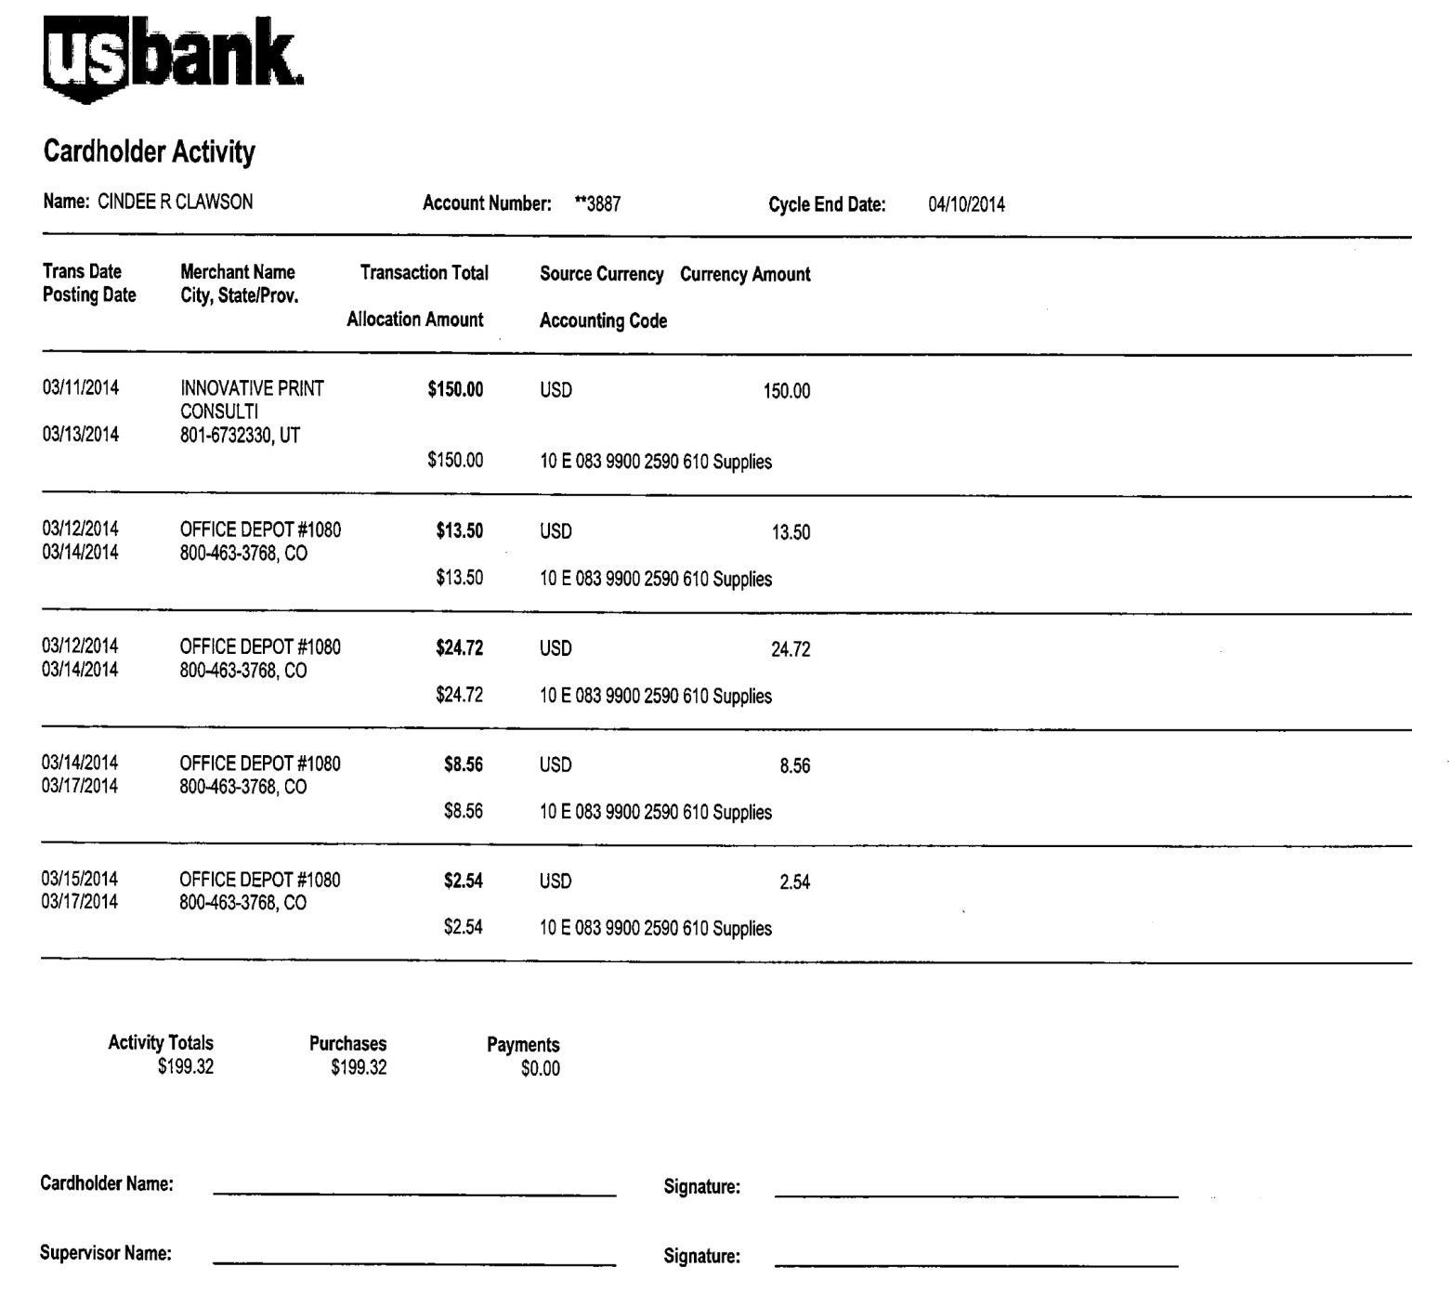
Sample Monthly Log (Account Activity Report)

Slide 12
Receipts/Other Considerations
Please place your receipts in order as they appear on your monthly account activity report!
Itemized receipts required for ALL purchases
  Especially food purchases (restaurants, grocery stores, etc.)
Please tape small receipts to a blank sheet of paper.
Please set your printer to print the log in landscape orientation. This may require you to change your browser.
Purchasing and Accounting

Slide 13
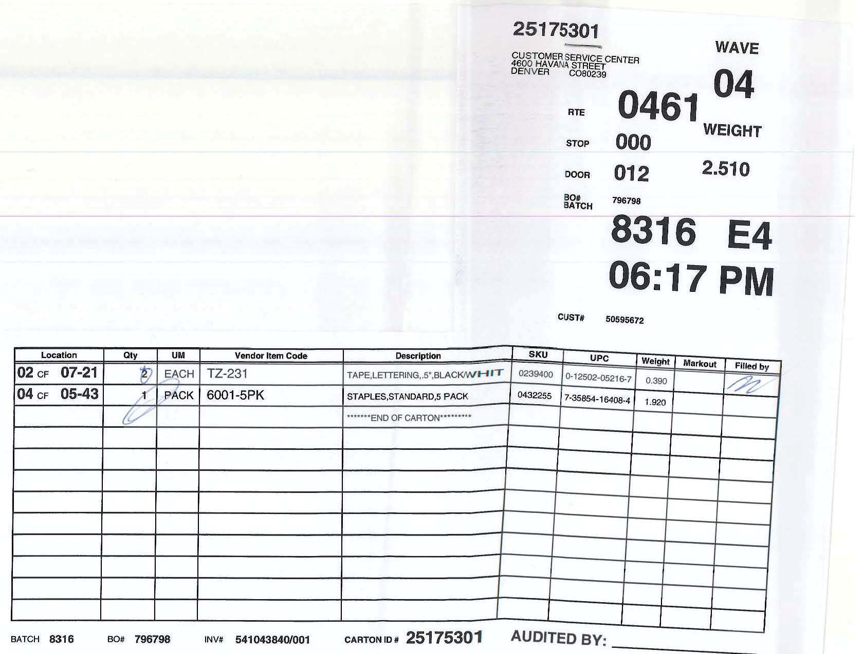
Sample Receipts
Packing Lists can’t be used as a receipt.

Slide 14
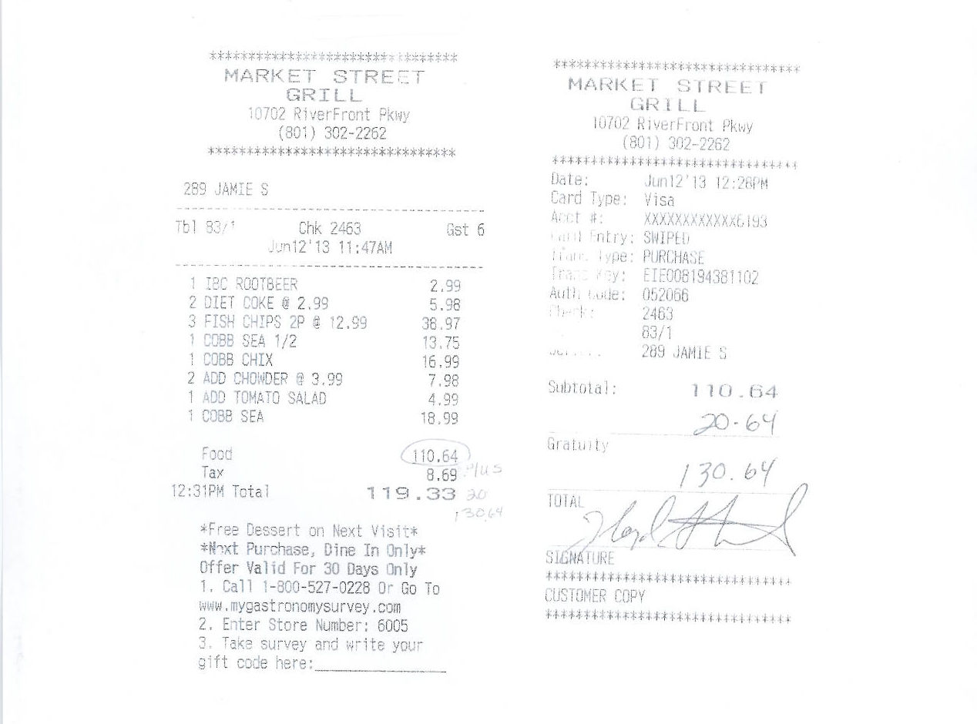

Slide 15
Summary
The Purchasing Card is designed to be simple and easy to use, providing you with the materials needed to perform your job more quickly and efficiently. However appropriate controls must be maintained to ensure the ongoing success of the program.
Monthly audits will be conducted on your card activity.
As we continue to improve the way we conduct business, your feedback is important!
Thank you!
Purchasing and Accounting

